Slide 1

WRAP Collection and Shipment Training

Slide 2
Training Overview: WRAP
Study Overview
Kit Review
Sample Collection and Processing
Sample Shipping
Sample Form
NCRAD Website
Common Nonconformance Issues
Questions?

Slide 3
WRAP Study Specimens
Biospecimen | Visit 1 | Visit 2 | Visit 3 | Visit 4 | Visit 5 | Visit 6 | Visit 7 | Visit 8 | Visit 9
Plasma | X | X | X | X | X | X | X | X | X
Buffy Coat (DNA) | X | X | X | X | X | X | X | X | X
Whole Blood | X | X | X | X | X | X | X | X | X
Serum | X | X | X | X | X | X | X | X | X
CSF | Madison only

Slide 4
Kit Request Module
http://kits.iu.edu/wrap/

Slide 5
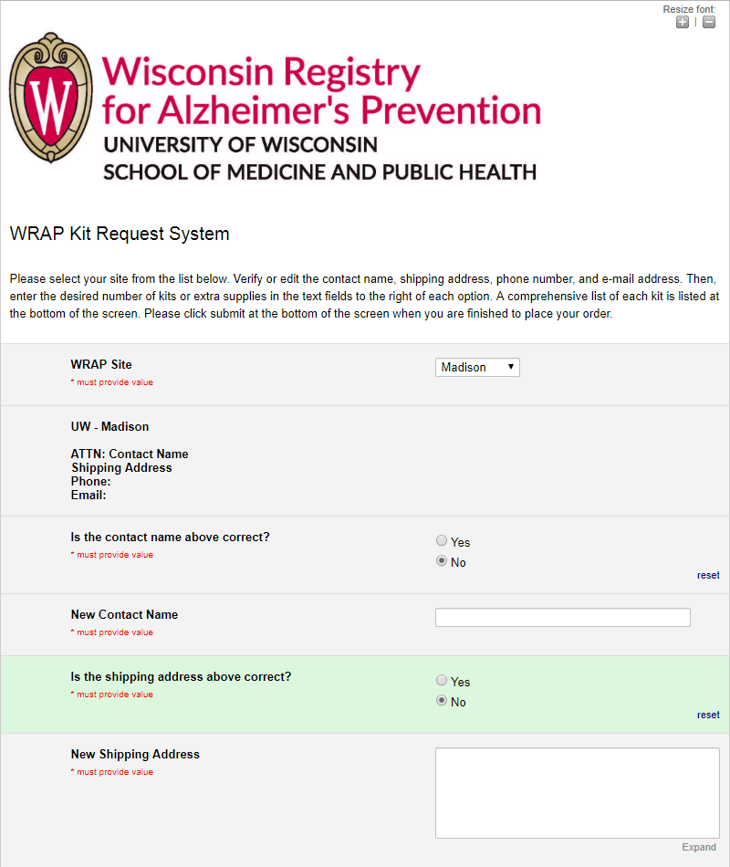
NCRAD Kit Request Module
Choose your site from the drop-down list.
The coordinator name and contact information will appear.
Verify that this information is accurate, or correct it if necessary.

Slide 6
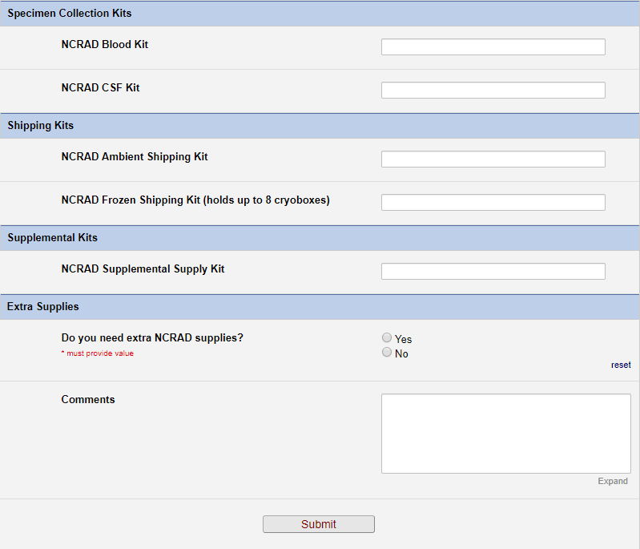
WRAP Kits
Madison site only

Slide 7
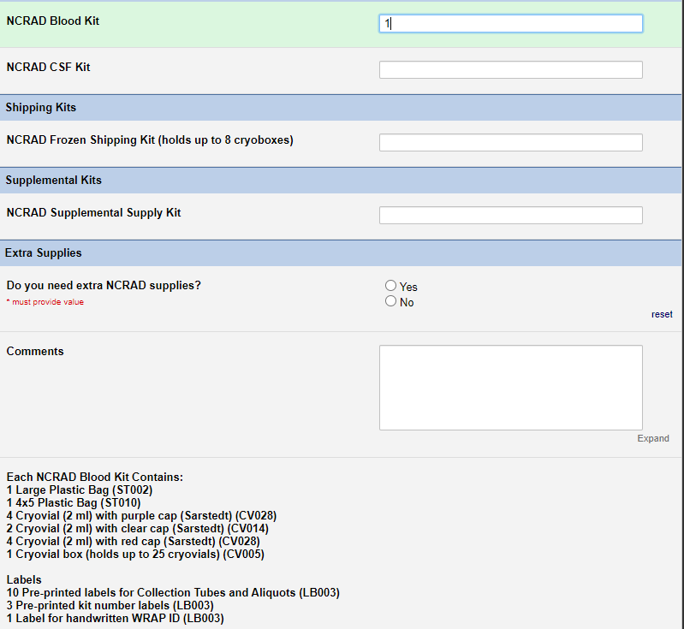

WRAP Kits
Indicate the quantity needed of each kit
Once selected, kit components of the chosen kit will appear at the bottom of the screen (Pictured)
Click “Submit” to turn in your request.
**Note: You can order more than one type of kit in a single kit request**

Slide 8
Specimen Labels

Slide 9
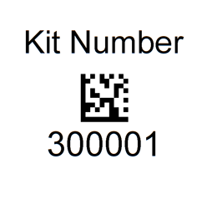
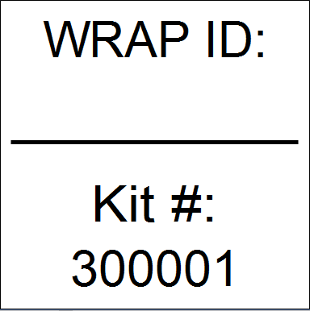
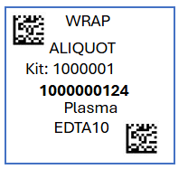
Three Label Types
Kit Number
WRAP ID
Specimen

Slide 10
Kit Number Labels
Used to track patient samples and provide quality assurance – Will be placed on the following locations :
  Blood and CSF Sample and Shipment Notification Forms
  Cryoboxes that houses aliquots during shipping
  One extra label provided
  Provided by NCRAD in the kits

Slide 11
WRAP ID Label
Subjects will be identified by their WRAP ID
Sites will be responsible for handwriting this onto the provided labels
  Must use Fine Point Sharpie Marker
  Each site will receive 3 markers in initial kit supply

Slide 12
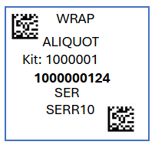
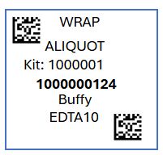
Specimen Labels –Serum, Plasma, and Buffy Coat
Only one label to be placed on ALL aliquot and Collection tubes
Serum
  From Serum tube
Plasma
  From EDTA tube
Buffy Coat
  From EDTA tube
Serum Tube
EDTA Tube
EDTA Tube

Slide 13
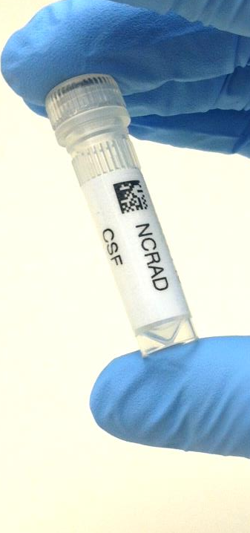
Specimen Labels –
Serum, Plasma, Buffy Coat, and CSF
Specimen tube label only
Please place barcode near cap

Slide 14
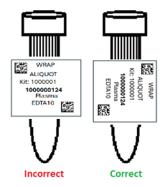
Labeling Biologic Samples
Please...
Label all collection and aliquot tubes before cooling, collecting, processing or freezing samples
Label only 1 subject’s tubes at a time to avoid mix-ups
Wrap the label around the tube horizontally. Label position is important for all tube types
Make sure the label is completely adhered by rolling between your fingers

Slide 15
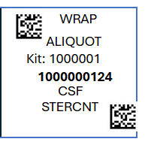
Specimen Labels - CSF
Separate Kit Number for CSF collection
  Kit number will differ from kit number used for the blood samples for the same subject at the same visit
CSF label
  CSF aliquots

Slide 16
Handling/Processing
Study Specimens

Slide 17
Blood Draw Order: Madison
Able to Confirm Fasting for 12 hours
One 4 ml red-top serum determination tube for Vitamin D 25-Hydroxy, Insulin, and B12
One 4 ml PST for Lipid panel, hs-CRP, and glucose
Research Kit
Tube Type | Number of Tubes Drawn
1. 9 ml Serum Determination (Red-Top) Tube | 1
2. 4 ml Serum Determination (Red-Top) Tube | 1
3. 10 ml Sodium Heparin (Green-Top) Tube | 2
4. 10 ml EDTA (Purple-Top) Tube | 4
OR
Unable to Confirm Fasting for 12 hours
One 4 ml red-top serum determination tube for Vitamin D 25-Hydroxy and B12
One 4 ml PST for Lipid panel and hs-CRP

Slide 18
Blood Draw Order: Milwaukee
1. Tube Use for Clinical Labs
2. Tube Use for Research Kit
Tube Type | Number of Tubes Drawn
1. 5 ml Gold-Top Tube | 3
Tube Type | Number of Tubes Drawn
1. 9 ml Red-Top Serum Separation Tube | 1
2. 10 ml Purple-Top EDTA Tubes | 4

Slide 19
Blood Draw Order: LaCrosse
1. Tube Use for Clinical Labs
2. Tube Use for Research Labs
Tube Type | Number of Tubes Drawn
1. 9 ml Red-Top Serum Separation Tube | 1
2. 10 ml Purple-Top EDTA Tubes | 4
Tube Type | Number of Tubes Drawn
1. 5 ml Red-Top Serum Separation Tubes | 2
2. 3 ml Mint Top Lithium Heparin Tube | 1
3. 1.5 ml Gray Top Tube | 1
4. 5 ml Yellow Top Tubes | 2
Tube Type | Number of Tubes Drawn
1. 9 ml Red-Top Serum Separation Tube | 1
2. 10 ml Purple-Top EDTA Tubes | 4

Slide 20



Cryovial Cap Colors (Samples going to NCRAD)
Cap Color | Sample Type | Cap Image
Red | Serum
Purple | Plasma
Clear | Buffy Coat
Clear | CSF

Slide 21
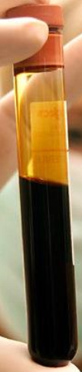
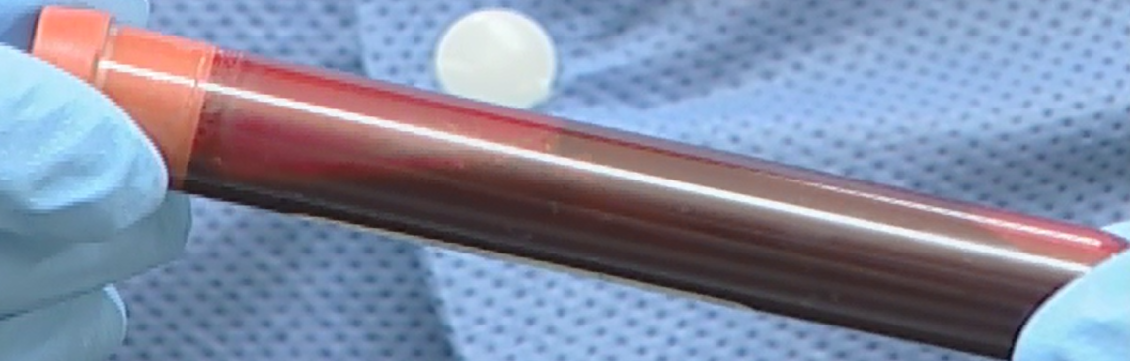

Serum Tube
Serum Tube
(Immediately after blood draw – pictured below)
** Please note: After standing at room temperature for 30 minutes, blood will be clotted and immobile**
Serum Tube (unfilled)
Serum Tube (after centrifuge)

Slide 22




Serum Preparation
Step One
Step Two
Step Three
Step Four
Serum
Label four red-capped cryovials with preprinted NCRAD “Serum” labels.
Label four red disc clear-capped cryovials with WRAP “Serum” labels.
Aliquot 0.5 ml into each cryovial.
Store serum aliquots upright at -80°C until shipment.
Spin, aliquot, and freeze aliquots within 2 hours of collection.
Store tubes at room temp.
Each tube should be labeled according to site-specific protocols.
Collect blood in Serum Tube allowing blood to flow for 10 seconds and ensuring blood flow has stopped.
Allow blood to clot for 30 minutes.
Centrifuge samples at 3000 rpm for 10 minutes at 4°C.

Slide 23

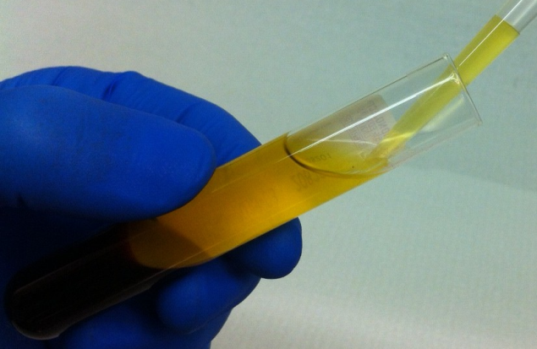
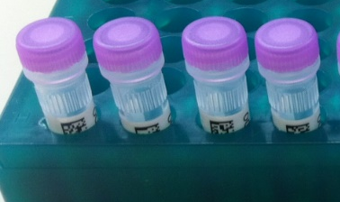
Plasma Collection
Create up to 4 aliquots
Please see the NCRAD YouTube Channel for tutorials:
http://kits.iu.edu/artfl-lefftds/videos

Slide 24
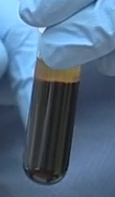

Buffy Coat Collection
NCRAD Tutorials: http://kits.iu.edu/artfl-lefftds/videos

Slide 25
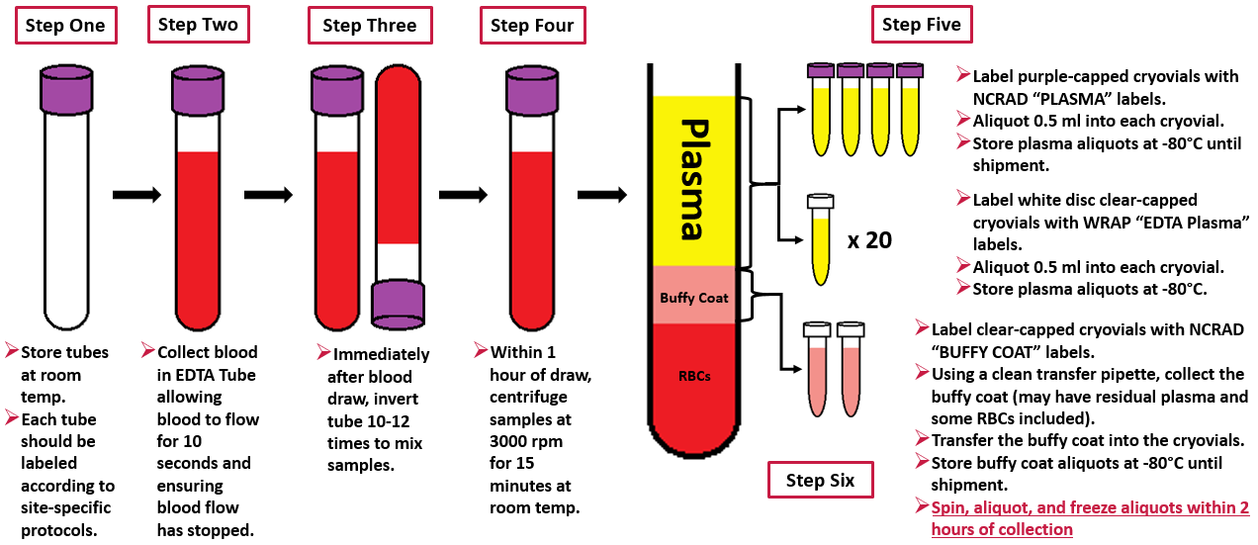
Plasma/Buffy Coat Collection and Processing

Slide 26
CSF Collection and Processing

Slide 27
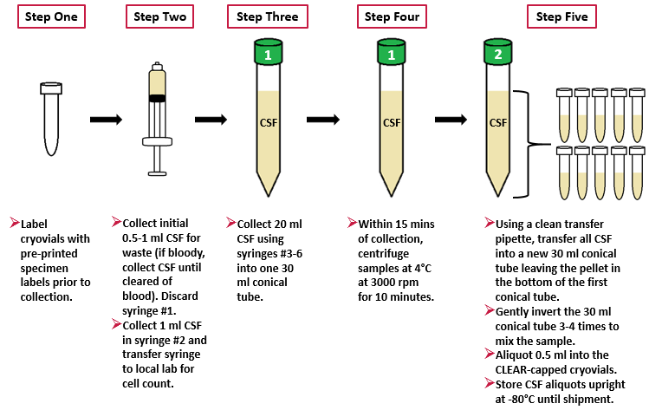
CSF Collection and Processing

Slide 28
Sample Shipments to NCRAD

Slide 29
Sample Shipment Summary
Collection Tube | Drawn At | Specimen Type | Aliquot Volume | Total Number of Aliquots | # of Samples sent to NCRAD | Shipping Temperature
2 Serum (Red-Top) Blood Collection Tube (9 ml) | All Visits | Serum | 0.5 ml serum aliquots | 8 | 4 | Frozen
3 EDTA (Purple-Top) Blood Collection Tube (10 ml) | All Visits | Plasma | 0.5 ml plasma aliquots | 24 | 4 | Frozen
 | All Visits | Buffy Coat | ~1.0 ml buffy coat aliquots | 2 | 2 | Frozen
1 EDTA (Purple-Top) Blood Collection Tube (10 ml) | All Visits | Whole Blood | 5 ml whole blood aliquots | 2 | 0 | N/A
Madison Site only
Collection Tube | Drawn At | Specimen Type | Aliquot Volume | Total Number of Aliquots | Number of Samples sent to NCRAD | Shipping Temperature
30 ml screw top centrifuge tubes with blue caps | All Visits | CSF | 0.5 ml CSF aliquots | 40 | 10 | Frozen
 | All Visits |  | 1 ml CSF aliquot (for local lab) | N/A | N/A | N/A

Slide 30
Frozen Shipment Packaging
All other samples shipped frozen to NCRAD
  Serum, Plasma, Buffy Coat, and CSF
  Ship Monday-Wednesday Only
Hold packaged samples in a -80°C freezer until pickup.
Include copy of Blood and/or CSF Sample Shipment and Notification Form
Batch samples together
  8 participant samples (Serum, Plasma, Buffy, CSF)
  Batch shipping should be performed quarterly or as a full shipment of specimens accumulates, whichever is sooner.

Slide 31
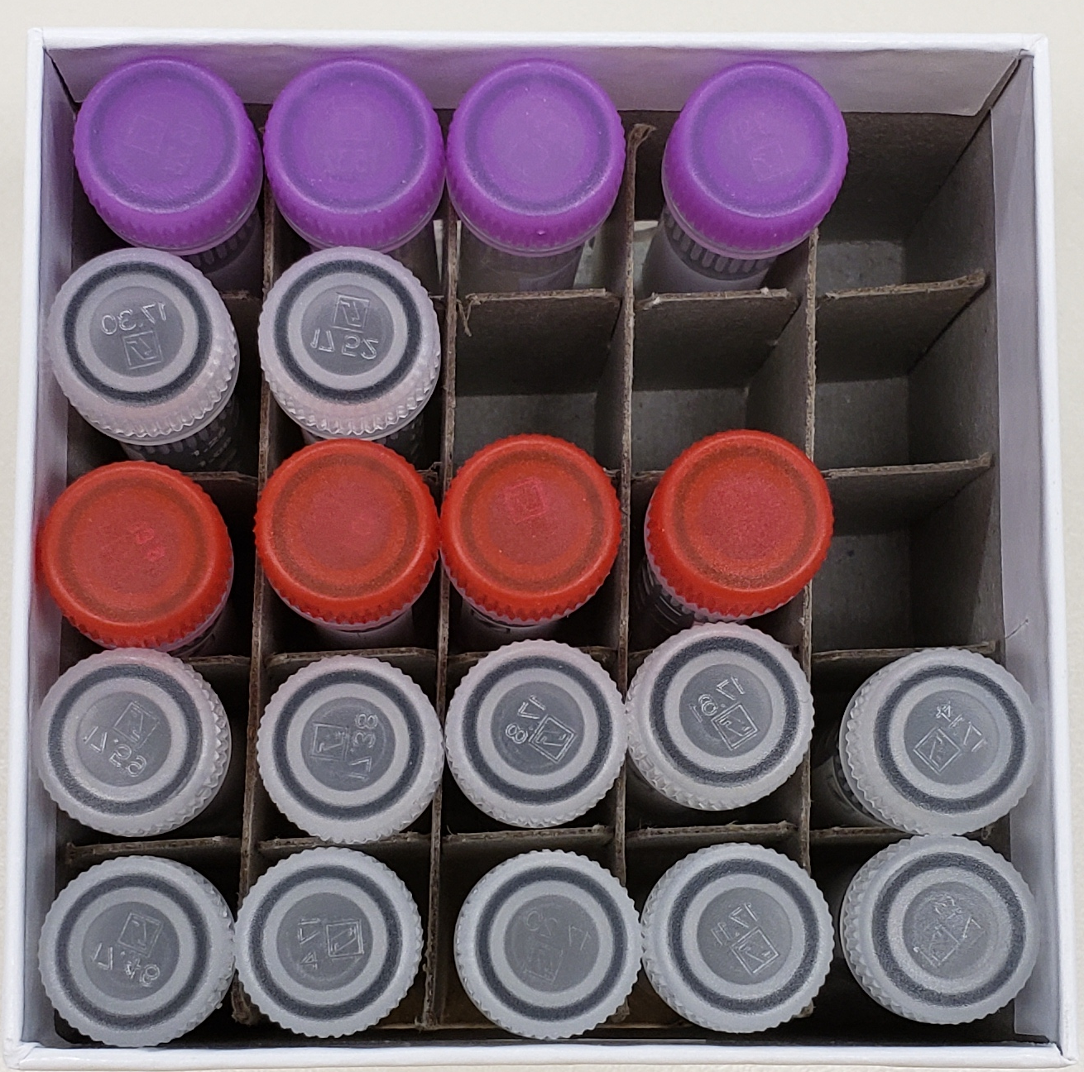
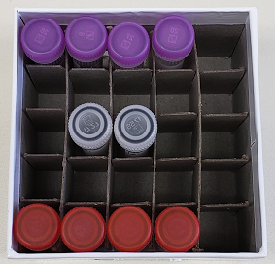
Shipping Frozen Samples
Plasma, Buffy Coat, Serum, and CSF Samples
Plasma, Buffy Coat, and Serum Samples

Slide 32
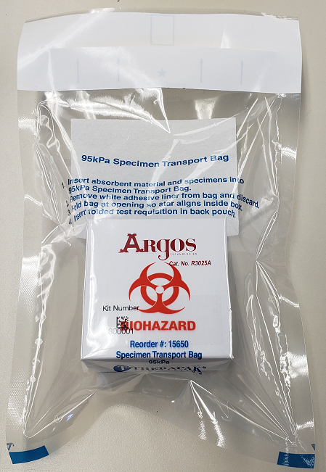
Frozen Shipment Packaging
Use the biohazard bag to package the 25-Slot Cryobox
Cryovial box placed in clear biohazard bag

Slide 33
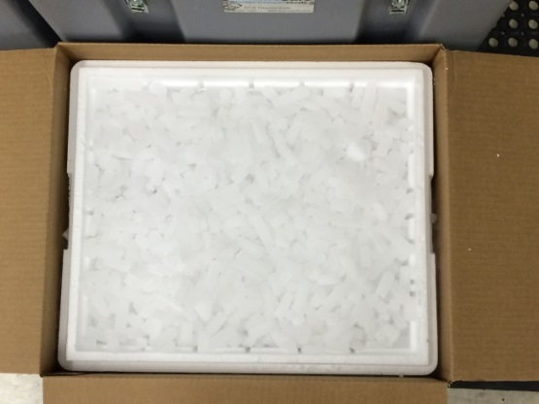
Frozen Shipping Packaging
Place 2-3 inches of dry ice in the bottom of the Styrofoam shipping container, then insert the cryoboxes laying upright.
Fully cover the cryoboxes with about 2 inches of dry ice in the provided shipper.
Each Styrofoam shipper must contain about 30-45 lbs (20 kg) of dry ice.

Slide 34
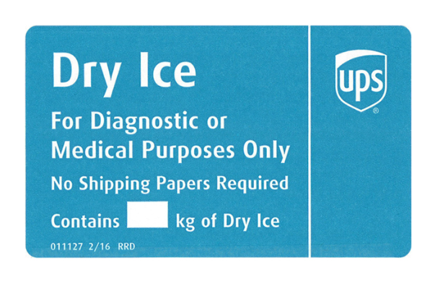
Frozen Shipping – Dry Ice Requirements
Dry Ice label should not be covered with other stickers and must be completed or the shipping carrier will reject/return your package!
Net weight of dry ice in kg
20

Slide 35
Blood and/or CSF Sample and Shipment Notification Form
A copy of the sample form must be emailed or faxed to NCRAD prior to the date of sample arrival.
Please include sample forms in all shipments of frozen and ambient samples.
Email: alzstudy@iu.edu
Fax: 317-321-2003

Slide 36
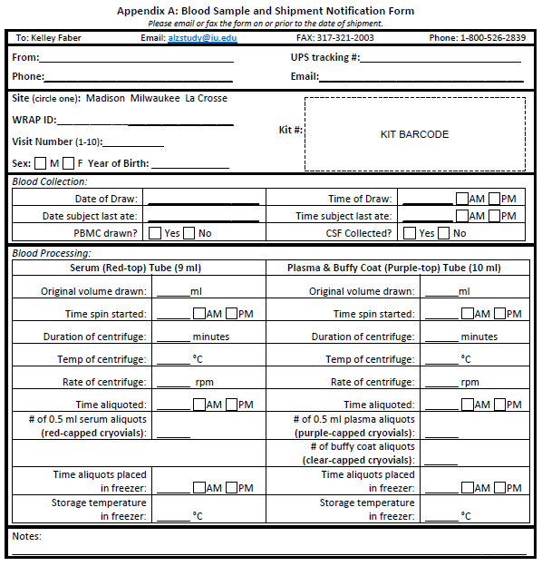
Blood Sample and Shipment Notification Form

Slide 37
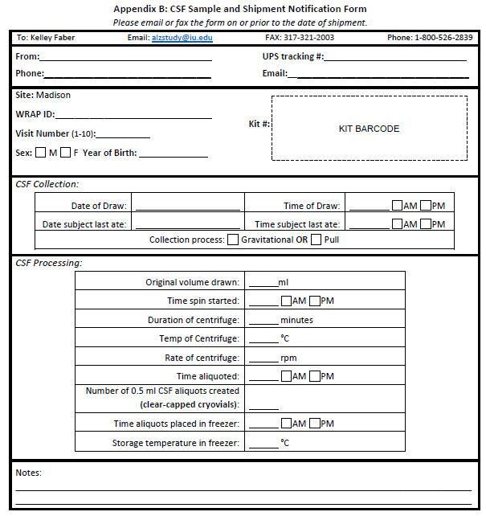
CSF Sample and Shipment Notification Form

Slide 38
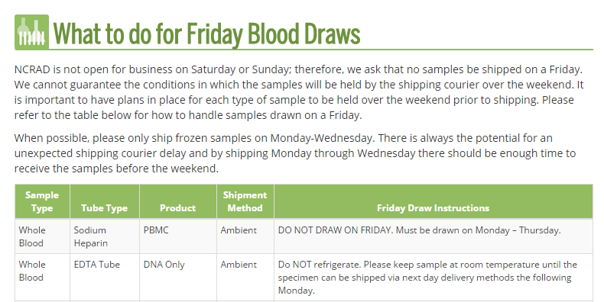
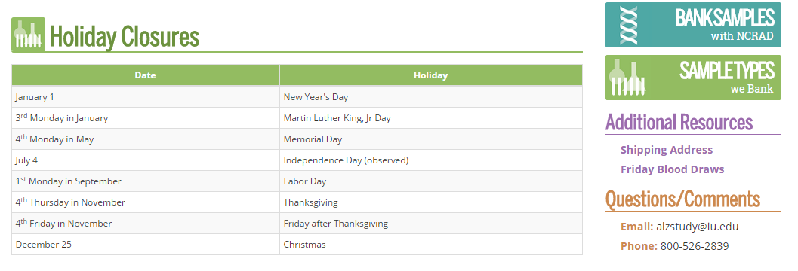
NCRAD Website
Helpful Pages
https://ncrad.org/holiday_closures.html
https://ncrad.org/friday_blood_draws.html

Slide 39
Nonconformance Issues
Recommendation:
Place aliquots in Argos boxes/tube rack in freezer upright until shipment
Sample aliquots and collection tubes frozen at an angle/inverted
Fields left blank on Blood/CSF Sample and Shipment Notification Forms
    Last time participant ate often left blank/unknown
Incorrect data reported on Sample and Shipment Notification Forms
Multiple low volume aliquots
Recommendation: Complete Sample Notification forms during the participant study visit as samples are processed.
Recommendation:
Lay out cryovials in a row and aliquot in order until plasma/CSF is depleted

Slide 40
Nonconformance Cont.
Aliquots arriving to NCRAD without labels
Sample forms not faxed or scanned to NCRAD the day before shipment
Recommendation:
Ship Samples to NCRAD utilizing the Notification Form, by WRAP ID. Do not throw away labels until samples are packed and shipped.

Slide 41
Contact Information
Questions?
  Ronae Williams
    Phone: (317) 278-9082
    E-mail: rdw2@iu.edu
  General NCRAD Contact
    Phone: (800) 526-2839
    E-mail: alzstudy@iu.edu
    Website: www.ncrad.org

