Slide 1
The Precision Aging Network: Healthy Minds for Life
in collaboration with the
The National Centralized Repository for Alzheimer’s Disease and Related Dementias (NCRAD)

Slide 2
Contact Information
Questions?
Please contact NCRAD Coordinator at:
Phone: 317-274-7890
CRC email: dlkeys@iu.edu
Back-up email: alzstudy@iu.edu
Website: www.ncrad.org

Slide 3
Training Overview:
Biofluid Collection Schedule
Kit Request Module
Specimen Labels
Handling/Processing Study Specimens
Sample Shipping
NCRAD Website
Questions?

Slide 4
PAN Biofluid Collection Schedule
Sample Type | Baseline | 2 Year Follow Up
Plasma | X | X
DNA | X | X
RNA | X | X
CSF* | X | X
*CSF collection is optional
Notes:
Whole blood is collected in three types of tubes (10ml Serum-Separator/SST Tube, 10ml lavender-top EDTA tube and 6ml EDTA tube). The 10ml red-top serum separator tube is processed locally into serum and then aliquoted, frozen at the study site and shipped to NCRAD. The 10ml EDTA tubes are processed locally into plasma and buffy coat fractions. They are then aliquoted, frozen at the study site, and shipped to NCRAD. The 6ml EDTA tube is frozen locally without further processing and shipped to NCRAD.

Slide 5
Kit Request Module
kits.iu.edu/pan

Slide 6
Kit Request Module
An initial stock of kits will be delivered prior to the designated site-specific start date.
Individual supplies are available to order:
Sample Aliquoting Supplies
Shipping Supply Kit
Individual Supplies

Slide 7
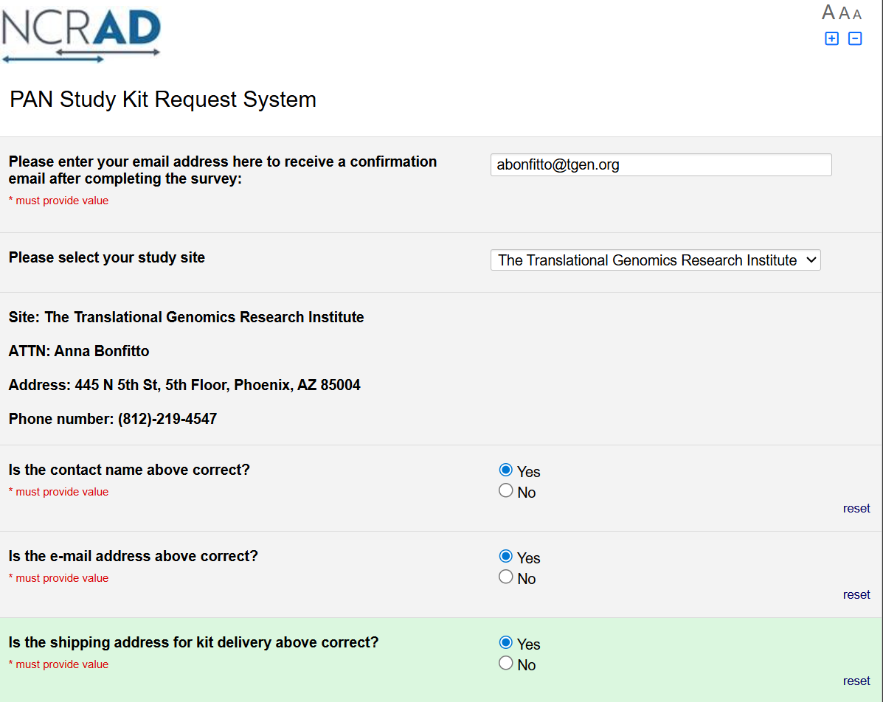
NCRAD Kit Request Module
Choose your site from the drop-down list
The coordinator name and contact information will appear
Verify that this information is accurate, correct if necessary

Slide 8
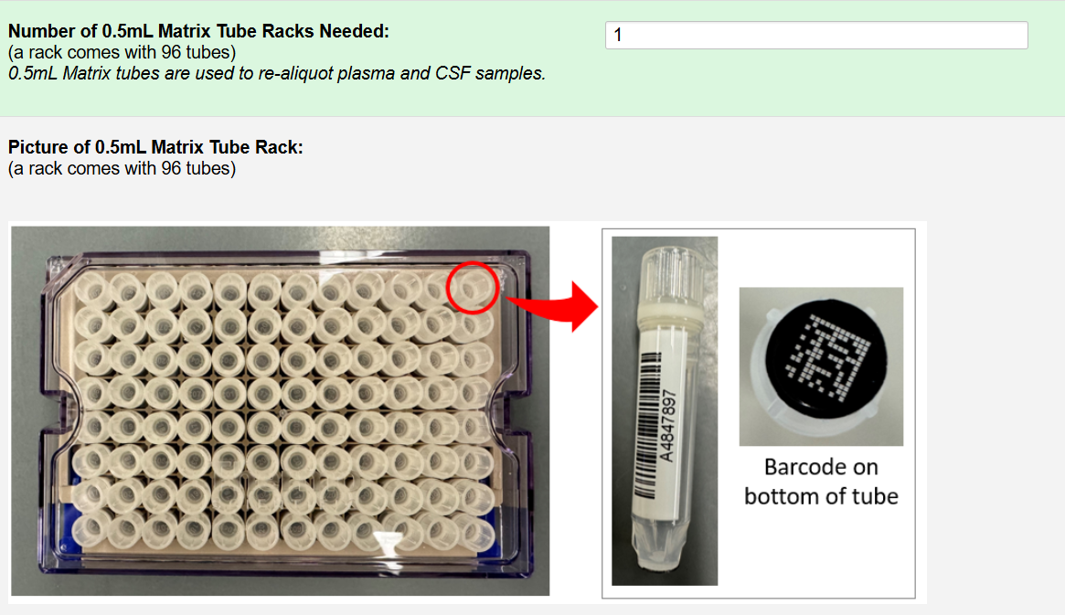
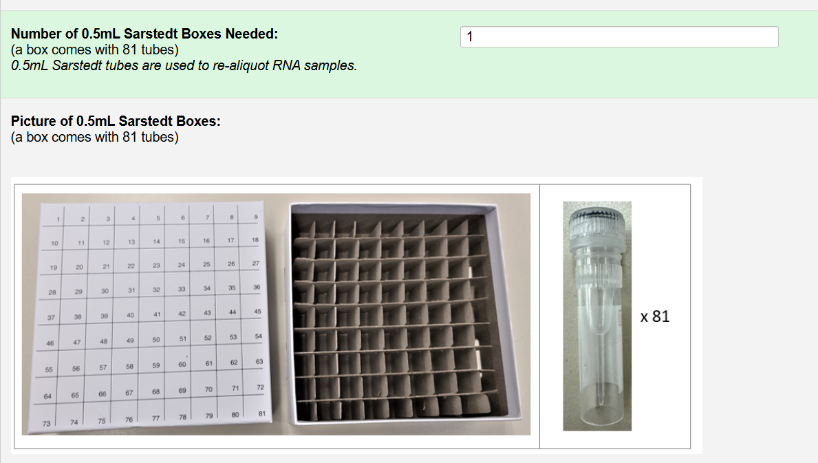
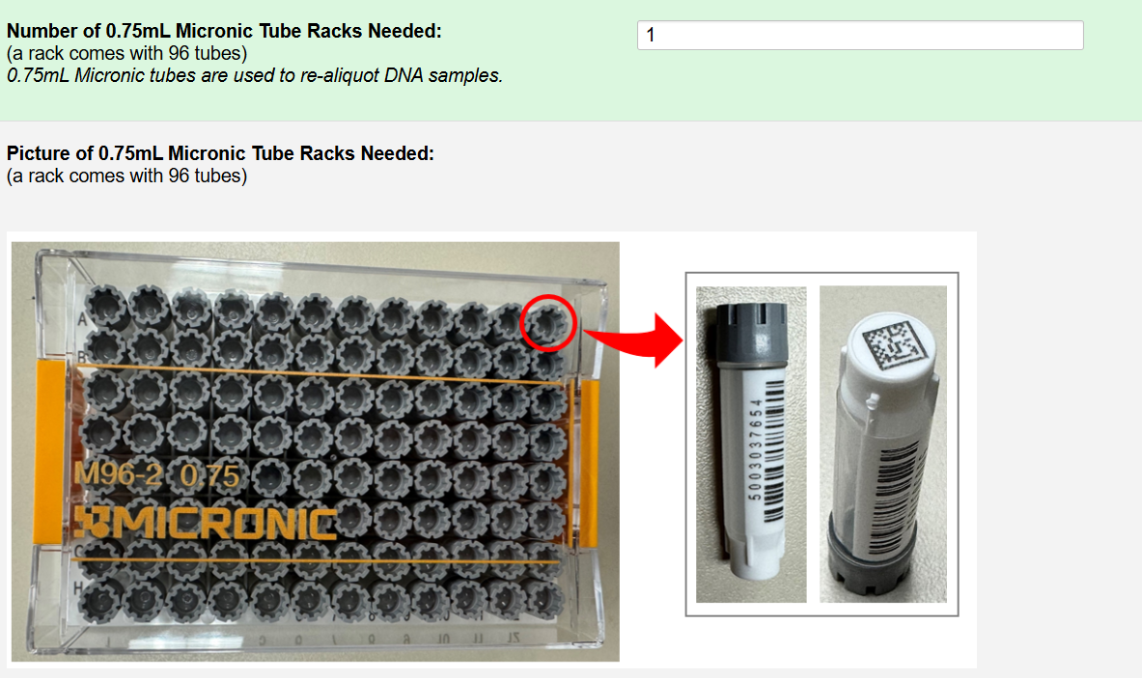
Individual Aliquoting Supplies Available

Slide 9
Individual Aliquoting Supplies
Indicate the quantity needed of each kit
Once selected, kit components of the chosen kit will appear at the bottom of the screen (Pictured)
Click “Submit” to turn in your request.
The IU staff will notify you that your request has been received and address any issues.
**Note: You can order more than one type of kit in a single kit request**

Slide 10
NCRAD Kit Request Module: When It Must be Used
Each site will be responsible for ordering kits (labels included) and maintaining supplies on site for scheduled participants
To order, sites will use the Indiana University online kit ordering module: kits.iu.edu/pan
Allow a minimum of 3 weeks for your order to be processed and delivered.

Slide 11
Specimen Labels

Slide 12
Label Type Summary
Collection Tube Label
RNA only

Slide 13
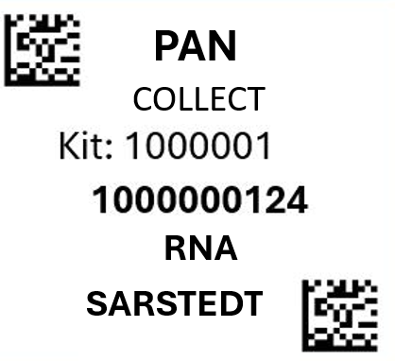
Collection Tube Label (RNA only)
Study name
Kit Number (assigned by NCRAD)
Specimen barcode (assigned by NCRAD
Specimen type

Slide 14
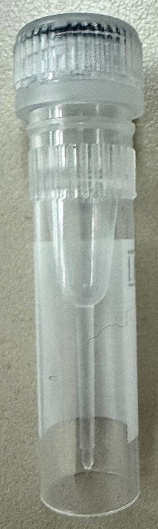
Collection & Aliquot Tube Labels – RNA Only
PLASMA
Collection and Aliquot tube label only
Notes:
Need new photo of micronic

Slide 15
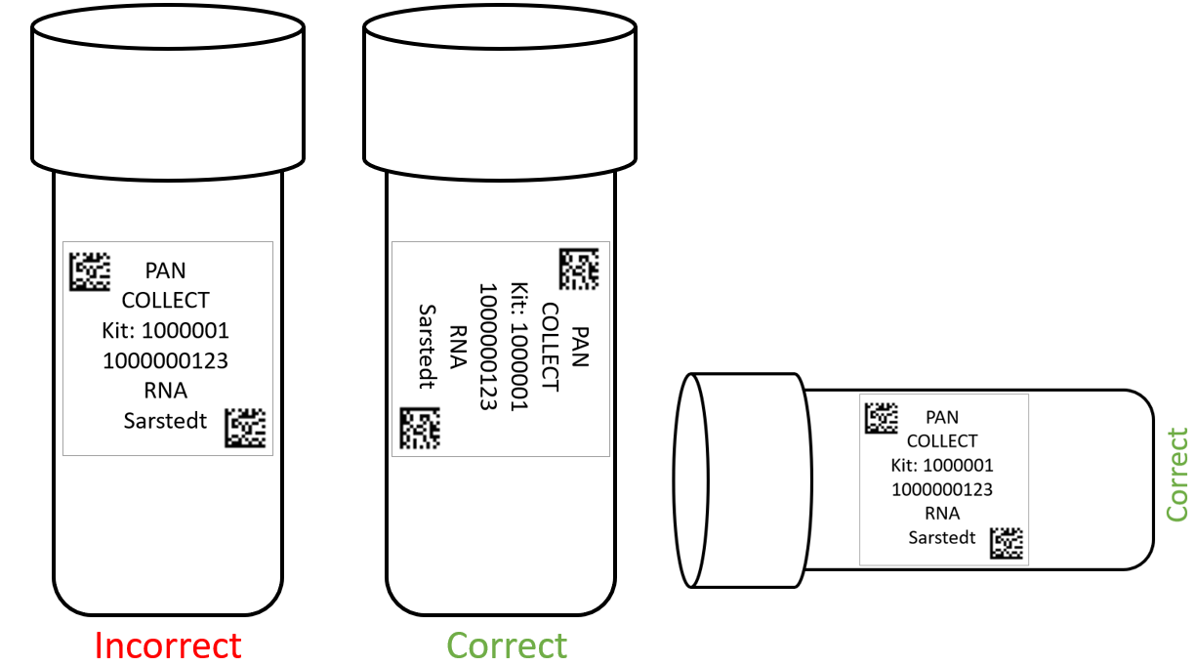
Labeling Biologic Samples
Please...
Label all collection and aliquot tubes before cooling, collecting, processing or freezing samples.
Label only 1 participant’s tubes at a time to avoid mix-ups.
Wrap the label around the tube horizontally. Label position is important for all tube types.
Make sure the label is completely adhered by rolling between your fingers.
Notes:
Is this accurate for the micronic tubes? ADD EXAMPLE OF collection tube as well!

Slide 16
Handling/Processing Study Specimens

Slide 17
Site Required Equipment
Dry ice pellets
-80⁰C Freezer
Notes:
Confirm if all needed for this study

Slide 18
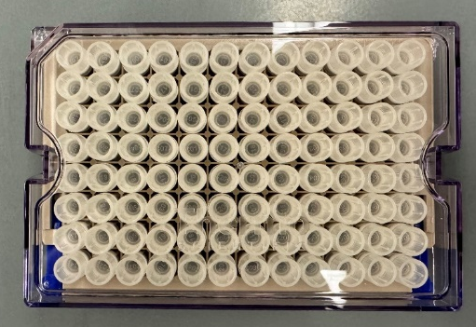
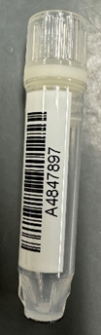
Sample Transfer – Plasma & CSF
Tube Type | Cryobox Type | Tubes Supplied | Racks Supplied | Supply Image
0.5mL Matrix Tube (Sent in cases of 96) | Matrix Tube Rack | 96 | 1
Notes:
UPDATE?

Slide 19
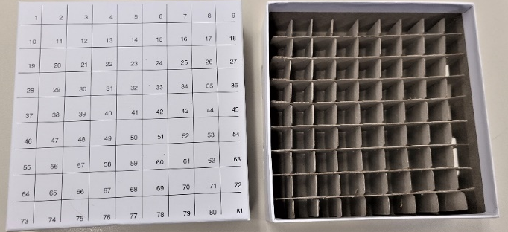

Sample Transfer – RNA
Tube Type | Cryobox Type | Tubes Supplied | Racks Supplied | Supply Image
0.5mL Sarstedt Tube (Sent in cases of 81) * Label specific | 81 cell cryobox | 81 | 1
Notes:
UPDATE?

Slide 20
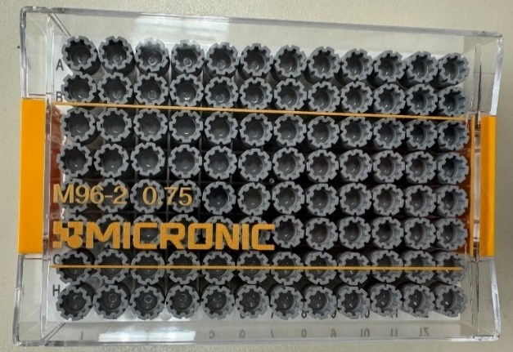
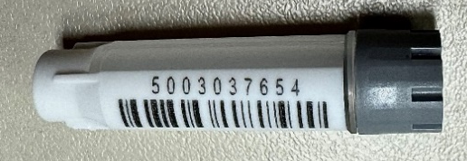
Sample Transfer – DNA
Tube Type | Cryobox Type | Tubes Supplied | Racks Supplied | Supply Image
0.75mL Micronic Tube (for DNA) Sent in cases of 96 | Micronic Cryobox | 96 | 1
Notes:
UPDATE?

Slide 21
Sample Shipping

Slide 22
Sample Shipment Summary
Sample Type | Aliquot Size | Aliquots per Visit | Max Aliquots per Box | Ship
DNA | 5ug | 1 | 96 | Frozen
RNA | 500ng | 2-6 | 81 | Frozen
Plasma | 0.5ml | 2-5 | 96 | Frozen
CSF | 1.0ml | 2-5 | 96 | Frozen
*FedEx Shipping

Slide 23
Frozen Sample Shipping
Ship Monday-Wednesday Only
Plasma
DNA
CSF
RNA
Hold packaged samples in a -80°C freezer until pickup.
Batch Samples together
4 cryoboxes
Batch shipping should be performed quarterly or as a full shipment of specimens accumulates, whichever is sooner.
Notes:
Which samples are sent frozen vs ambient??

Slide 24
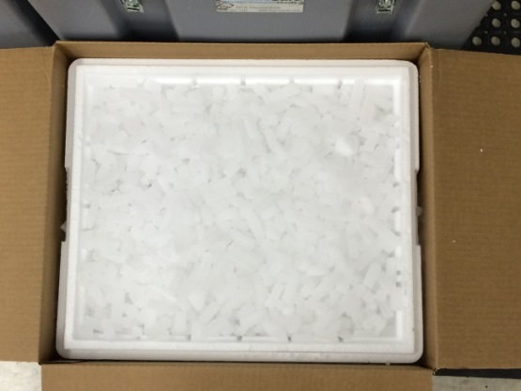
Frozen Shipping – Dry Ice Requirements
Fully cover the cryoboxes with about 2 inches of pelleted dry ice in the provided shipper.
Each Styrofoam shipper must contain about 45 lbs (20 kg) of dry ice.

Slide 25
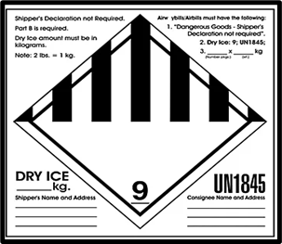
Frozen Shipping (FedEx) – Dry Ice Requirements
Dry Ice label should not be covered with other stickers and must be completed or the shipping carrier will reject/return your package!
The site and NCRAD will need to fill out the UN 1845/Class 9 Dry Ice Dangerous Goods label below and place it on the outside of the shipping container:
The site will need to complete the shipper and consignee information and record the dry ice weight (outline in yellow).
NCRAD address:
NCRAD
351 West 10th Street TK-217
Indianapolis, IN 46202
800-526-2839
20.4
Net weight of dry ice in kg

Slide 26
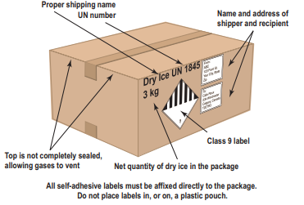
Frozen Shipping- Box

Slide 27
Shipping Regulations and Training
PLEASE NOTE:
All study personnel responsible for shipping should be certified in biospecimen shipping.
It is the responsibility of each site to ensure that the appropriate training has been provided and conducted in regards to IATA shipping.

Slide 28
UN3373 Biological Substance, Category B Training
Biological Substance, Category B are specimens being transported for “investigational purposes”
Recommend: investigator sites document training of category B/dangerous goods
We recommend establishing a record of your staff’s training and date of instruction
The training records must be made available upon request by the appropriate national authority
Additional information from the Department of Transportation (DOT) can be found on their website http://hazmat.dot.gov

Slide 29
Biological Sample and Shipment Manifest Forms
A copy of the sample form must be emailed to NCRAD prior to the date of sample arrival.
Please include sample forms in all shipments of frozen and ambient samples.
Email: alzstudy@iu.edu

Slide 30
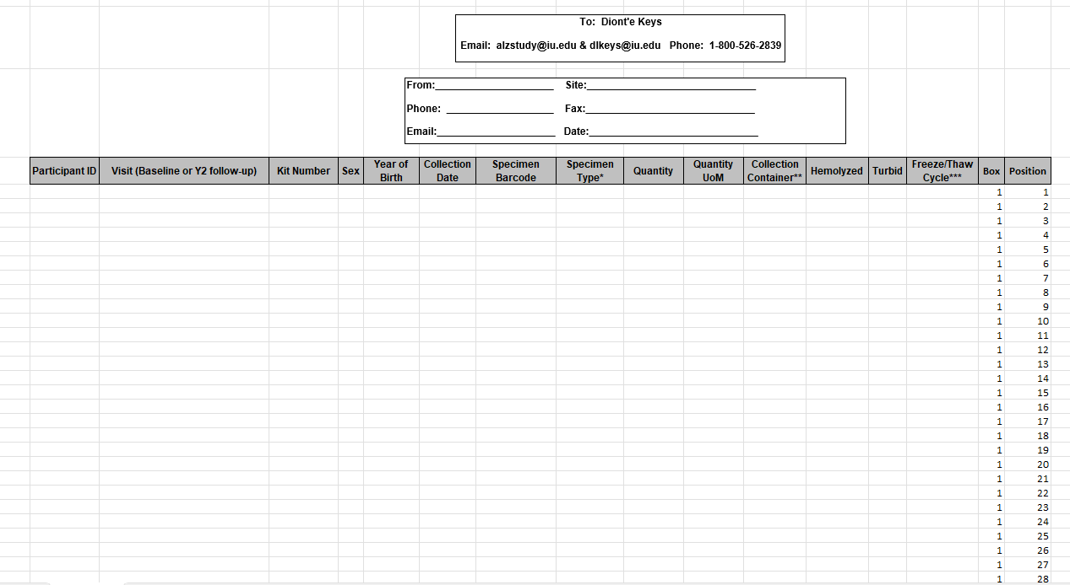
Biological Sample Shipping Manifest Form
Included sample types:
RNA
Plasma
Buffy Coat/DNA
CSF
A shipping manifest will need to be complete prior to the shipping of samples
Send by E-mail and include a copy in each shipment

Slide 31
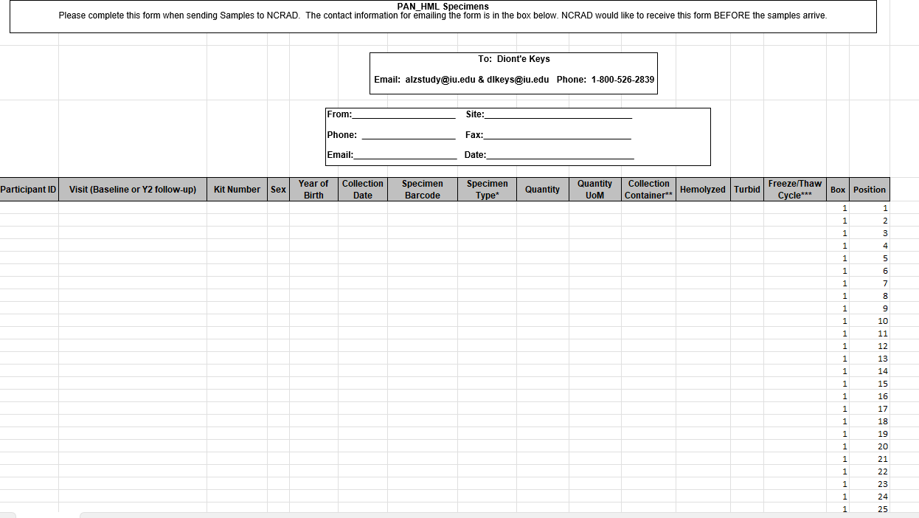

Shipping Frozen Samples
Ship CSF, RNA, Plasma, and DNA samples frozen
Send Biological Sample and Shipment Manifest Forms to IU (US) ahead of shipment
Email: alzstudy@iu.edu
cc: dlkeys@iu.edu

Slide 32
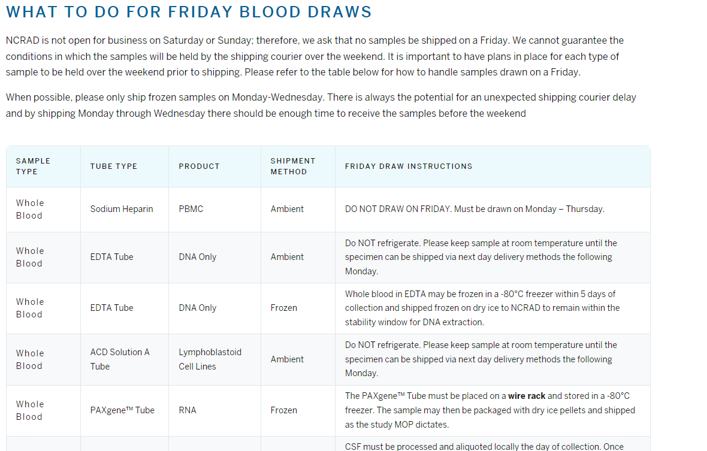
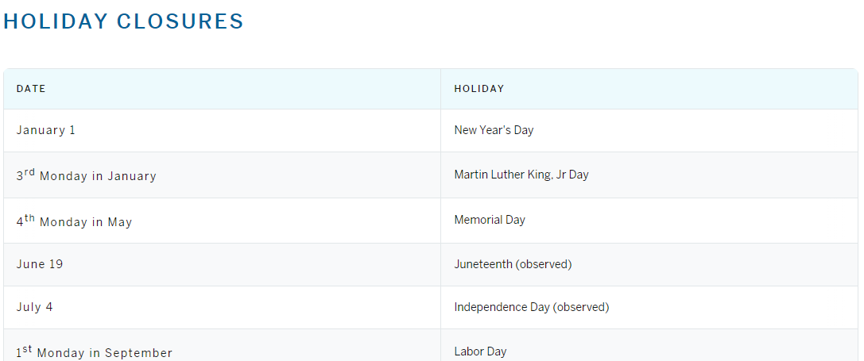
NCRAD Website Helpful Pages
NCRAD - Friday Blood Draws
NCRAD - Holiday Closures
Notes:
UPDATE FOR SAMPLE TYPES?

Slide 33
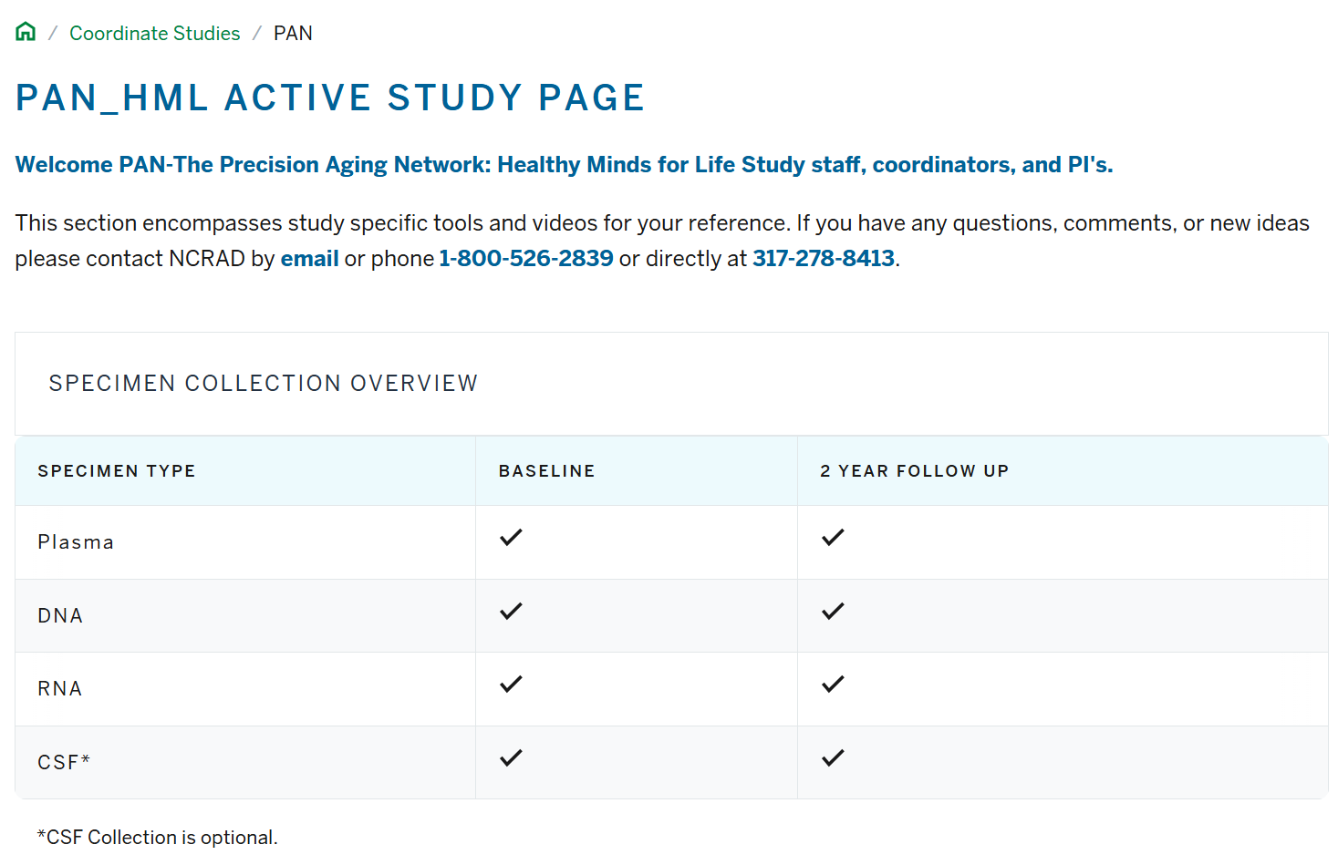
PAN_HML Active Study Page
Notes:
UPDATE PHOTO

Slide 34
Contact Information
Questions?
Please contact NCRAD Coordinator at:
Phone: 317-274-7890
CRC email: dlkeys@iu.edu
Back-up email: alzstudy@iu.edu
Website: www.ncrad.org

