Slide 1
Alzheimer’s Disease Family Based Study (AD-FBS) in collaboration with The National Centralized Repository for Alzheimer’s Disease and Related Dementias (NCRAD)
Biofluids Collection Training Slides
Notes:
Hello! Thank you for taking the time to be here today to review the sample collection, processing, and shipping procedures for the AD FBS study. My name is ________ and I am the coordinator for your study here at NCRAD.

Slide 2
Contact Information
Questions?
Please contact NCRAD Coordinators at:
Phone: 1-800-526-2839 or 317-278-1133
E-mail: alzstudy@iu.edu or rdw2@iu.edu
Website: www.ncrad.org
Notes:
Our contact information is listed here, with the general NCRAD phone and email listed first, and my work information listed second.

Slide 3
Training Overview:
Specimen Collection Schedule
Kit Request Module
Specimen Labels
Handling/Processing Study Specimens
Sample Shipping
NCRAD Website
Questions?

Slide 4
Specimen Collection Schedule
Draw Order | Sample Collected | Collection Tube | Visit Collected (CI & CN)
1 | Whole Blood (for PBMC isolation) | 2 x Sodium Heparin (Green-Top) Blood Collection tube (10 ml) | All
2 | Whole Blood (for plasma & buffy coat isolation or for DNA isolation) | 2 x EDTA (Lavender-Top) Blood Collection Tube (10 ml) | All
3 | Whole Blood (for Genetic Testing) | 1 x EDTA (Lavender-Top) Blood Collection Tube (3 ml) | Genetic Testing is now done primarily through Invitae. This kit should only be ordered and used for rare cases that are approved by FBS study management.
4 | Whole Blood (for RNA isolation) | 1 x PAXgeneTM Blood Collection Tube (2.5 ml) | All
Notes:
Here is the specimen collection schedule. At a study visit you may collect:
2 x whole blood samples for PBMC isolation
2 x whole blood samples for plasma and buffy coat isolation or for DNA isolation
1 x whole blood sample for CLIA genetic testing
1 x whole blood sample for RNA isolation
Please note that whole blood for PBMC, plasma/buffy coat or DNA, and RNA will be drawn at every study visit. Whole blood for genetic testing will only be drawn from a select few participants and only ever once over their entire course of participation in the study. When this sample is collected, you will do so before collecting the whole blood for RNA sample.

Slide 5
Kit Request Module
https://redcap.uits.iu.edu/surveys/?s=Je4P26ijtv
Notes:
NCRAD supplies all of the items that are needed to collect and ship the samples drawn for the AD FBS study. Your site will order all of the necessary supplies via the Kit Request Module, which can be accessed at the link here.

Slide 6
Kit Request Module
Kits and individual supplies are available to order:
Blood Kit A: Plasma/Buffy Coat, PBMC, RNA
Blood Kit B: DNA, PBMC, RNA
Blood Kit C: PCM Trials
Blood Kit D: Genetic Testing Kit
Genetic Testing is now done primarily through Invitae. This kit should only be ordered and used for rare cases that are approved by FBS study management.
Saliva Kit
Frozen Shipping Supply Kit
Any individual supplies needed
Notes:
Using the kit request module, you can request the following things: Blood Kits A through D, saliva kits, frozen shipping supply kits, and any individual items you may need.

Slide 7
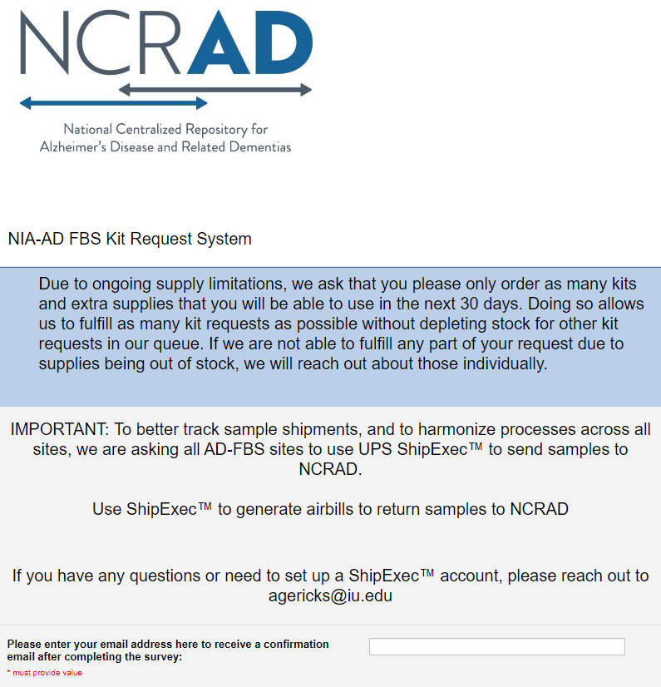
NCRAD Kit Request Module
Reminder: only order kits/supplies that will be used within 30 days of receipt.
Enter your email address – this is how you will receive updates about your order.
Notes:
When you open the kit request module, it will look like the image here. We ask sites to only order supplies that they will use within 30 days. This allows us to fulfil as many kit requests as possible without depleting stock for other kit requests in our queue. Additionally, some items have expiration dates, so this ensures that none of the items you receive will expire before you are able to use them.
The first thing you will do in the kit request module is enter your email address. All updates about your order will be directed to the email entered here, so please respond accordingly.

Slide 8
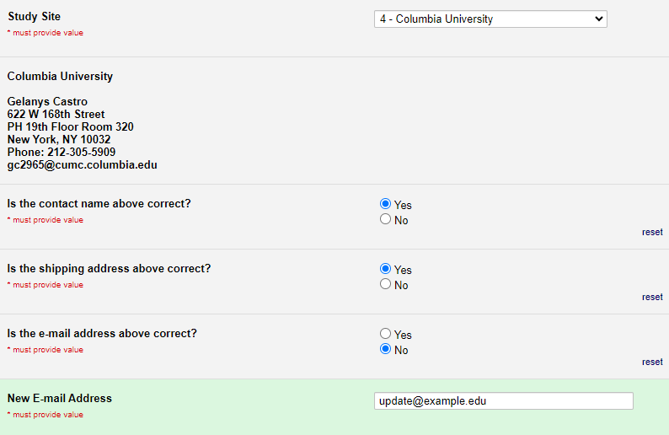
NCRAD Kit Request Module
Choose your site from the drop-down list
The coordinator name and contact information will appear
Verify that this information is accurate, correct if necessary
Notes:
Next you will choose your site from the drop-down list, which will cause your site contact and shipping information to automatically pop up. Please verify that this information is accurate.

Slide 9
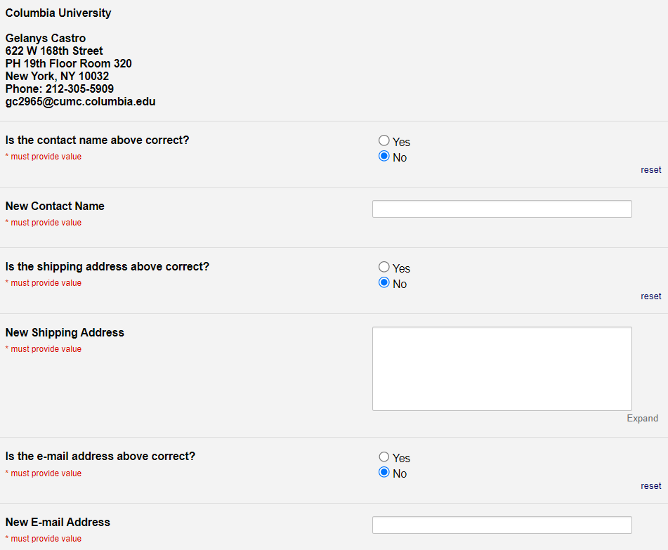
NCRAD Kit Request Module
If any information needs updated, select “no.”
Enter the correct information in the box that appears.
Notes:
If you indicate that anything is incorrect, a box will appear where you can enter the right information.

Slide 10
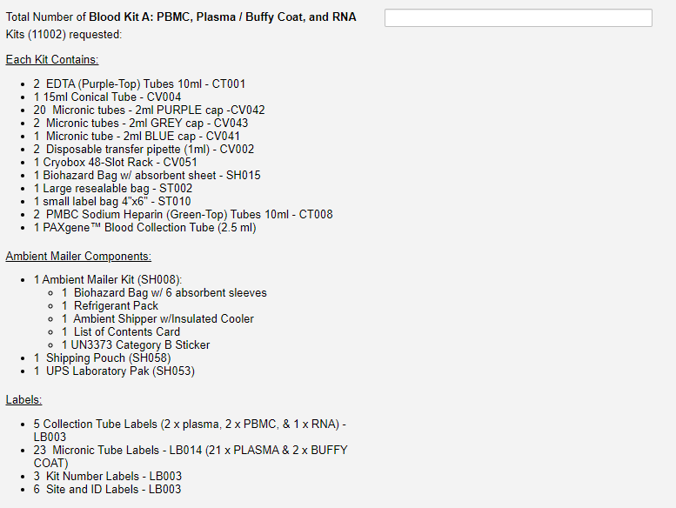
NCRAD Kit Request Module
Indicate the quantity needed of each kit
Notes:
Scrolling down, you will see all of the kit we offer, with a description of their contents listed. For each kit type, please enter the quantity needed. If you do not need a certain kit, please leave the field blank, as opposed to entering a zero.

Slide 11
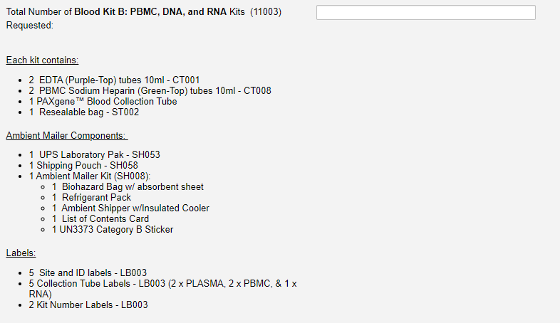
NCRAD Kit Request Module
Indicate the quantity needed of each kit
Notes:
Here you can see blood kit b.

Slide 12
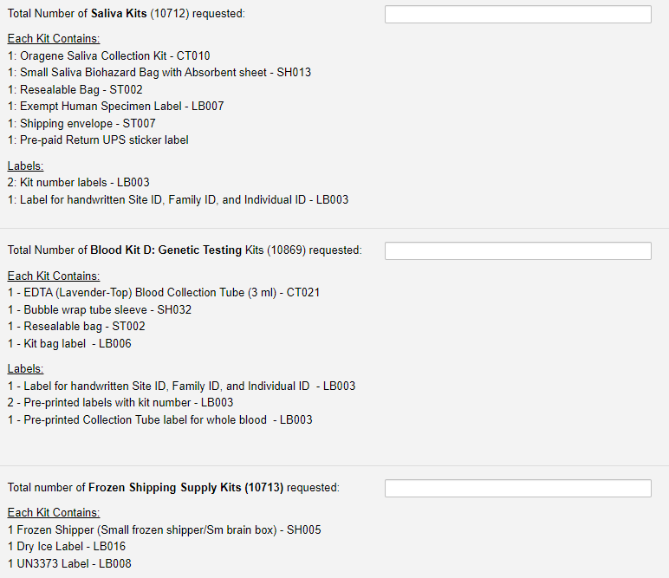
NCRAD Kit Request Module
Indicate the quantity needed of each kit
Notes:
This shows the saliva kits, blood kit d, and shipping kits.

Slide 13
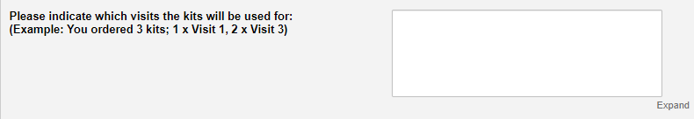
NCRAD Kit Request Module
At the bottom, indicate which visit the kit(s) will be used for.
Notes:
Towards the bottom of the survey, there will be a box that asks you to enter the visit that each ordered kit will be used for. This is critical information for us in order to prepare your kits. In general, please do not order kits unless you know which visit it will be used for.

Slide 14
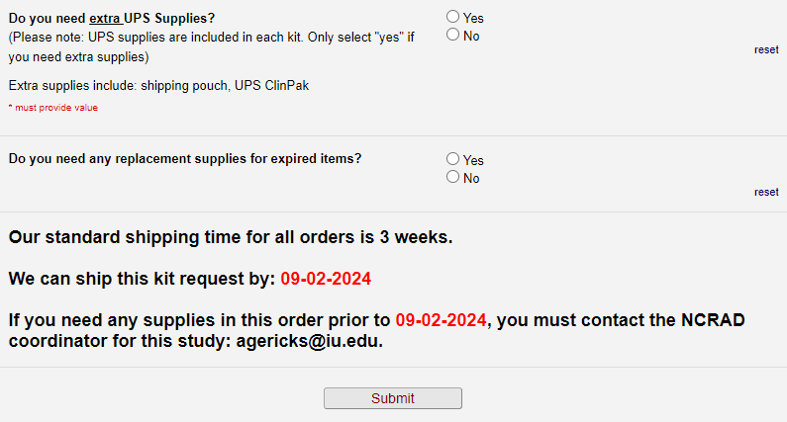
NCRAD Kit Request Module
Indicate if you need extra UPS shipping supplies.
Indicate if you need to replace any expired items.
The module automatically calculates the date in 3 weeks. This is when you can expect your kit to ship by.
Click Submit.
Notes:
You will indicate if you need any extra shipping supplies, or any replacement items for things that may have expired. Please note that if you have a kit with tubes that have expired, please do not discard the entire kit. Only discard the expired items and then submit a kit request to have those specific items replaced.
Our standard shipping time for all orders is 3 weeks. The system will automatically calculate the date 3 weeks out. If supplies are needed sooner, please submit the request like normal and then email me immediately to let me know when the order is needed.

Slide 15
After Placing Your Order
After clicking “submit” you should receive an email confirming that NCRAD received your request.
The IU staff will notify you if there are any issues or questions.
You will be notified when the supplies are shipped out to your site.
Notes:
After clicking “submit” you should receive an email confirming that NCRAD received your request. We will notify you if there are any issues or questions. You will receive an email when the supplies are sent out to your site, along with a tracking number so you can monitor the shipment.

Slide 16
NCRAD Kit Request Module: When It Must be Used
Each site will be responsible for ordering kits (labels included) and maintaining supplies on site for scheduled participants.
To order, sites will use the Indiana University online kit ordering module: https://redcap.uits.iu.edu/surveys/?s=Je4P26ijtv
Allow a minimum of 3 weeks for your order to be processed and delivered.
Notes:
Each site is responsible for ordering kits and maintaining supplies for their participants. The link to the kit request module is listed again here. Remember to please allow 3 weeks for your order to be processed. While we can normally accommodate rush orders, these should be an exception, and the expectation is that you will plan ahead 3 weeks.

Slide 17
Kit Types
Notes:
While going through the kit request module, you saw that there were different types of kits that can be ordered. We are now going to walk through those different kit types and when to use them.

Slide 18
Kit Types
Kit Type | Used When…
Blood Kit A: PBMC, Plasma/Buffy Coat, & RNA | The participant CAN come into the site in person for blood collection.
Blood Kit B: PBMC, DNA, & RNA | The participant canNOT come into the site in person for blood collection and processing, and a remote phlebotomist (PCM Trials) is NOT being used.
Blood Kit D: Genetic Testing Kit | The youngest affected individual in a qualifying family. Genetic Testing is now done primarily through Invitae. This kit should only be ordered and used for rare cases that are approved by FBS study management.
Saliva Kit | Blood collection is not possible.
Notes:
Supplies needed for sample collection are provided in a kit. Blood Kit A is used to collect Whole blood for PBMC, plasma & buffy coat, and RNA. This kit should be ordered when the participant is able to come into your site in person. Blood kit B is used to collect whole blood for PBMC, DNA, and RNA. This kit should be ordered when the participant is NOT able to come into your site in person and you are sending them the supplies to have a remote phlebotomist collect the samples. Please note that if you are using PCM trails to do a blood draw, they will order the kits they need to complete the draw. Blood Kit D is used to collect whole blood for CLIA genetic testing. This kit should be ordered when you have a qualifying individual. Information regarding qualifying individuals can be found in your study protocol, and any questions about inclusion or exclusion for CLIA genetic testing should be directed to Dolly at Columbia. Lastly, saliva kits should be used when blood collection is not possible. These are rarely ordered.

Slide 19
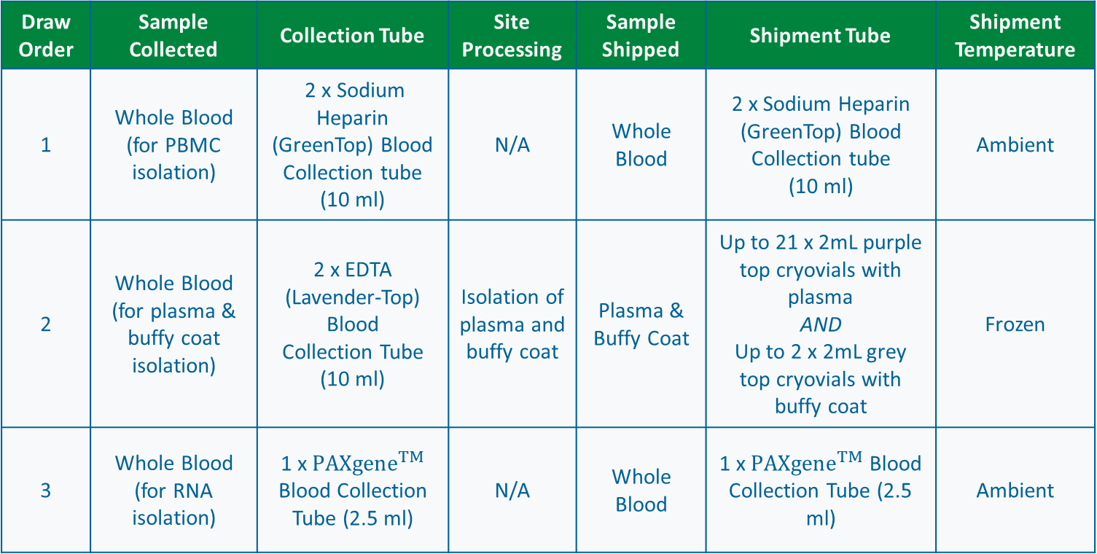
Kit A: PBMC, Plasma/Buffy Coat, & RNA
Draw Order | Sample Collected | Collection Tube | Site Processing | Sample Shipped | Shipment Tube | Shipment Temperature
1 | Whole Blood (for PBMC isolation) | 2 x Sodium Heparin (GreenTop) Blood Collection tube (10 ml) | N/A | Whole Blood | 2 x Sodium Heparin (GreenTop) Blood Collection tube (10 ml) | Ambient
2 | Whole Blood (for plasma & buffy coat isolation) | 2 x EDTA (Lavender-Top) Blood Collection Tube (10 ml) | Isolation of plasma and buffy coat | Plasma & Buffy Coat | Up to 21 x 2mL purple top cryovials with plasma AND Up to 2 x 2mL grey top cryovials with buffy coat | Frozen
3 | Whole Blood (for RNA isolation) | 1 x ${PAXgene}^{TM}$ Blood Collection Tube (2.5 ml) | N/A | Whole Blood | 1 x ${PAXgene}^{TM}$ Blood Collection Tube (2.5 ml) | Ambient
Notes:
Here is more detailed information on Blood Kit A. You will first draw 2 whole blood samples into sodium heparin tubes. Then you will draw 2 whole blood samples into 10ml EDTA tubes. Lastly, you will draw a whole blood sample into a PAXgene tube. The filled sodium heparin and PAXgene tubes will be shipped ambient to NCRAD without any further processing at your site. The 2 blood samples collected in the EDTA tubes will be processed at your site into plasma and buffy coat aliquots, which you will then ship frozen to NCRAD.

Slide 20
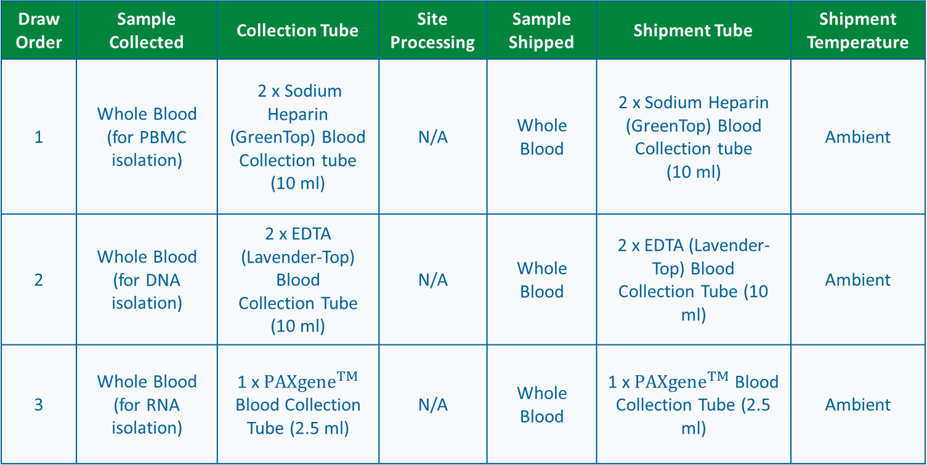
Kit B: PBMC, DNA, & RNA
Draw Order | Sample Collected | Collection Tube | Site Processing | Sample Shipped | Shipment Tube | Shipment Temperature
1 | Whole Blood (for PBMC isolation) | 2 x Sodium Heparin (GreenTop) Blood Collection tube (10 ml) | N/A | Whole Blood | 2 x Sodium Heparin (GreenTop) Blood Collection tube (10 ml) | Ambient
2 | Whole Blood (for DNA isolation) | 2 x EDTA (Lavender-Top) Blood Collection Tube (10 ml) | N/A | Whole Blood | 2 x EDTA (Lavender-Top) Blood Collection Tube (10 ml) | Ambient
3 | Whole Blood (for RNA isolation) | 1 x ${PAXgene}^{TM}$ Blood Collection Tube (2.5 ml) | N/A | Whole Blood | 1 x ${PAXgene}^{TM}$ Blood Collection Tube (2.5 ml) | Ambient
Notes:
Blood kit B will be sent to your site and you will then send it directly to a participant’s home. The participant will take the blood kit to a location of their choosing to have their blood drawn. The location of their choosing will draw the specimens outlined on this slide. It will then be the participant’s responsibility to ship the samples ambient back to NCRAD.

Slide 21
Kit D: Genetic Testing Kit
Draw Order | Sample Collected | Collection Tube | Site Processing | Sample Shipped | Shipment Tube | Shipment Temperature
Immediately following the 2 x 10mL EDTA tubes | Whole Blood (for Genetic Testing) | 1 x EDTA (Lavender-Top) Blood Collection Tube (3 ml) | N/A | Whole Blood | 1 x EDTA (Lavender-Top) Blood Collection Tube (3 ml) | Frozen
Genetic Testing is now done primarily through Invitae. This kit should only be ordered and used for rare cases that are approved by FBS study management.
Notes:
Blood kit D is for the collection of 1 whole blood sample into a 3ml EDTA tube. This should be collected at a regularly scheduled visit, and should be drawn immediately following the 2 x 10mL EDTA tubes, and before drawing the PAXgene tube. The filled 6ml EDTA tube should be shipped frozen to NCRAD.

Slide 22
Saliva Kit
Draw Order | Sample Collected | Collection Tube | Site Processing | Sample Shipped | Shipment Tube | Shipment Temperature
N/A | Saliva | Oragene Saliva Tube | N/A | Saliva | Oragene Saliva Tube | Ambient
Notes:
The saliva kit is relatively straight forward, and is used to collect saliva when you are unable to get blood from the participant. This sample is shipped ambient to NCRAD.

Slide 23
Specimen Labels
Notes:
Each kit you order will come with specimen labels that need to be placed specifically. We will now talk about the procedures for sample labeling.

Slide 24
Label Type Summary
Kit Number Label
Site ID, Family ID, and Individual ID Label
Collection Tube Label
Cryovial Label
Differ by specimen type
Notes:
You may see these 4 different label types in kits you receive.

Slide 25
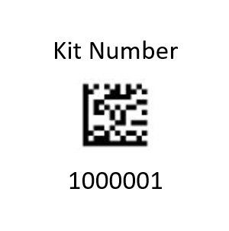
Kit Number Labels
Used to track patient samples and provide quality assurance
Tie together all specimens collected from one participant at one visit.
Will be placed on the following locations:
Biological Sample and Shipment Notification Form
Outside cryobox that houses aliquot tubes during storage and shipment
Provided by NCRAD in the kits
Notes:
Kit number labels are used to track patient samples and tie together all specimens collected from one participant at one visit. Kit number labels should be placed on the Biological sample and shipment notification form, and on the outside of the cryobox/biohazard bag that house tubes during storage and shipment.

Slide 26
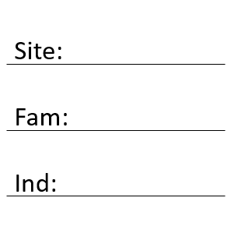
Site, Family, and Individual ID Label
Participants will be identified by their site, Family, and Individual ID
Sites will be responsible for handwriting this onto the provided labels
Must use fine point permanent marker
Each site will receive 4 markers in initial kit supply
Place one label on each blood collection tube.
Notes:
The Site Family and Individual ID labels provide blank spaces for you to handwrite these three IDs that identify a subject. You must write these IDs with a fine point permanent marker prior to labeling the tubes. After filling in the labels, you will place one on each blood collection tube.

Slide 27
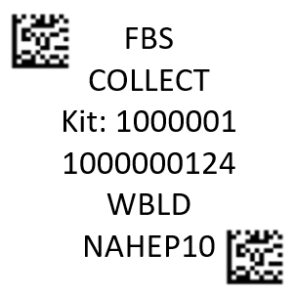
Collection Tube Labels
Study Name
Collection Tube Designation
Kit # (unique to the subject and visit)
Specimen Barcode (unique for each tube)
Sample Type
Collection Container
Place one label on each blood collection tube.
Notes:
Collection Tube Labels are to be placed on each blood collection tube in your kit. These labels have the study name, specimen barcode, sample type, and kit number. Please note that the kit number on a collection tube label should exactly match the one on the kit number label.

Slide 28
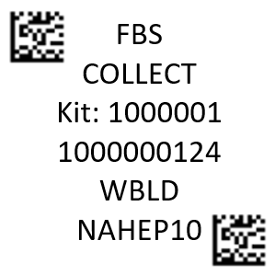
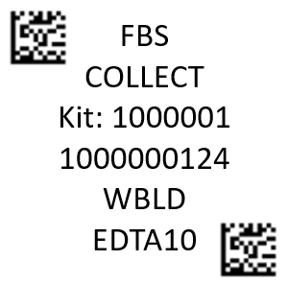
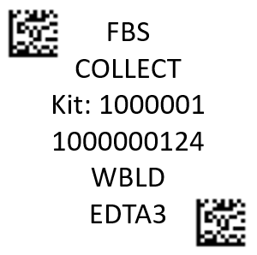
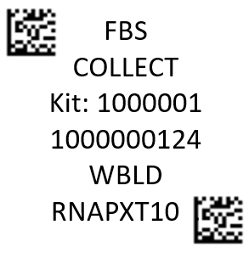
Collection Tube Labels
Every combination of Sample Type and Collection Tube that you may encounter.
Look to the Sample Type & Collection Tube lines to determine what tube / cryovial the label should be placed on
Notes:
Collection Tube Labels are to be placed on each blood collection tube in your kit. These labels have the study name, specimen barcode, sample type, and kit number. Please note that the kit number on a collection tube label should exactly match the one on the kit number label.

Slide 29
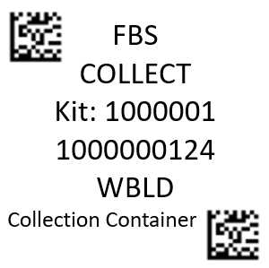
Specimen Labels: Blood Collection Tubes
Each collection tube will contain two labels: the Collection Tube Label and the Site ID, Family ID, and Individual ID Label. Be sure to place labels in the same configuration consistently among tubes.
The Collection Tube label should be placed at the top of the tube, with the left-hand barcode label near the cap of the tube.
The handwritten Site ID/Family ID/Individual ID Labels near the bottom of the tube.
All PBMC, EDTA, and PAXGene™ collection tubes will have two labels:
Label 1: Collection Tube Label
Label 2: Site, Family, and Individual ID Label
Label 1:
Label 2:
Notes:
Now you’ve seen all 4 types of labels that you will encounter. In summary, let’s go over the labels that will go on your blood collection tubes. These are your sodium heparin, EDTA, and PAXGene tubes. They will all have two labels: the collection tube label, and the site and Site/Family/Individual ID label. These are shown here.

Slide 30
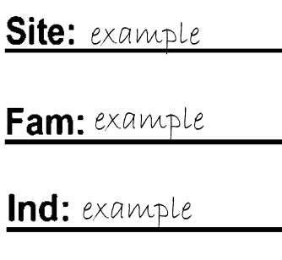
Specimen Labels: Blood Collection Tubes
Please ensure the left-hand barcode is near the cap
*Genetic Testing is now done primarily through Invitae. This tube should only be ordered and used for rare cases that are approved by FBS study management.
2 x 10mL Sodium Heparin (NaHep) PBMC Tubes
2 x 10mL EDTA Lavender-Top Tubes
1 x 10mL RNA PAXGene Tube
*1 x 3mL EDTA Lavender-Top Tube
Notes:
This is an image showing how to adhere the labels to your Collection tubes. The Collection tube label should be placed at the top, horizontally, with the left hand barcode closest to the cap. The Site/Family/Individual ID label should go on the bottom of the tube, also horizontally. Again, please ensure the handwritten ID label is filled out prior to placing it on the tubes.

Slide 31
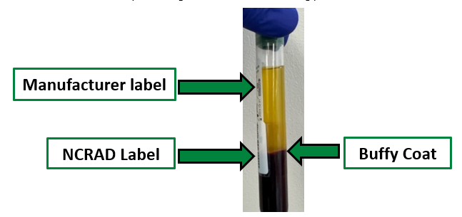
Specimen Labels: PBMC Collection Tubes
For Sodium Heparin tubes, please align the Collection Tube Label and Site ID/Family ID/Individual ID Label with the manufacturer’s label on the tube so that the buffy coat is visible to the NCRAD laboratory staff during processing.
Clear, visible line of sight to the sample vertically down the tube
Notes:
For Sodium Heparin tubes, please align the Collection Tube Label and Site/Family/Individual ID Label with the manufacturer’s label on the tube so that thre is a clear line of sight down the entire length of the tube.

Slide 32
Cryovial Tube Labels
Place one Cryovial Label on each blood aliquot cryovial. Note: these are only applicable to Blood Kits A & C.
Remember Blood Kit C is for PCM Trials only.
Specimen type is indicated on the label.
PLA = Plasma
BUF = Buffy Coat
FBS
1000001
PLA
FBS
1000001
BUF
Notes:
Cryovial labels are used on all of the cryovials in your kit. Please note that these labels are only applicable to Kits A and C.

Slide 33
Specimen Labels: Labeling Guidelines
Place Collection Tube and Aliquot Labels on ALL collection tubes and cryovials BEFORE sample collection. This should help to ensure the label properly adheres to the tube before exposure to moisture or different temperatures.
Using a fine point permanent marker, fill-in and place the Site ID/Family ID/Individual ID Labels on the Collection Tubes BEFORE sample collection. These labels are placed on collection tubes in addition to the Collection Tube Label.
The Collection Tube Labels contain two 2D barcodes. Place the left-hand barcode toward the tube cap.
Place label horizontally on the tube (wrapped around sideways if the tube is upright).
Take a moment to ensure the label is completely adhered to each tube. It may be helpful to roll the tube between your fingers after applying the label.
Notes:
In general, here are some things to keep in mind when it comes to labels…

Slide 34
Labeling Breakdown by Kit Type
Notes:
It can also be useful to review the specific labels you will see in each kit type.

Slide 35
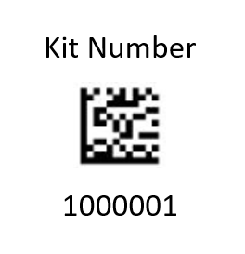
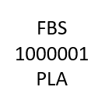

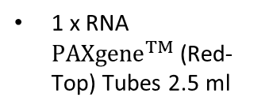
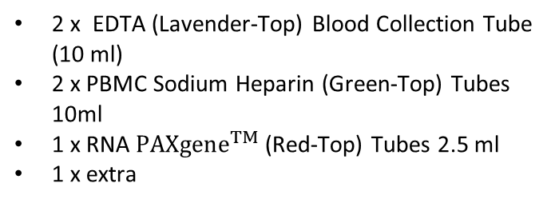
Kit A: PBMC, Plasma/Buffy Coat, & RNA Labels
Kit Number Labels
Site ID, Family ID, and Individual ID Labels
1 x placed on the Sample Form
1 x placed on the outside of the cryobox that houses aliquot tubes during storage and shipment
3 x extra (dispose if not used)
2 x EDTA (Lavender-Top) Blood Collection Tube (10 ml)
2 x PBMC Sodium Heparin (Green-Top) Tubes 10ml
1 x RNA ${PAXgene}^{TM}$ (Red-Top) Tubes 2.5 ml
1 x extra
Collection Tube Labels
Cryovial Labels
2 x EDTA (Lavender-Top) Blood Collection Tube (10 ml)
20 x Micronic tubes - 2ml PURPLE cap
1 x Micronic tube - 2ml BLUE cap
2 x PBMC Sodium Heparin (Green-Top) Tubes 10ml
1 x RNA ${PAXgene}^{TM}$ (Red-Top) Tubes 2.5 ml
2 x Micronic tubes - 2ml GREY cap
Notes:
In Blood Kit A, you will receive 3 kit number labels. 1 should be placed on the sample form, 1 should be placed on the outside of the cryobox that houses plasma & Buffy Coat aliquots, and 1 will be provided as an extra. If unused, please throw away this extra label. You will also receive 21 cryovial labels that say PLASMA. Place 1 on each of the purple and blue cap micronic tubes. There will be 2 cryovial labels that say BUFFY COAT, which should be placed on the grey cap micronic tubes. The kit will also come with 6 site/family/individual ID labels. After filling these out, they should be placed on the 2 EDTA, 2 Sodium Heparin, and 1 PAXgene tubes. There will be 1 extra that you can keep as a backup at your site, as long as it is blank. You will receive 2 collection tube labels that say PLASMA, which should be placed on the 2 10ml EDTA tubes. The 2 collection tube labels that say PBMC should be placed on the 2 sodium heparin tubes, and the one collection tube label that says RNA should be placed on the PAXgene tube.

Slide 36
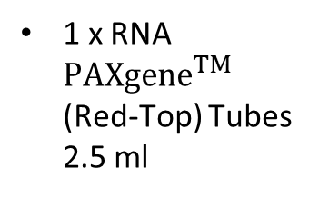
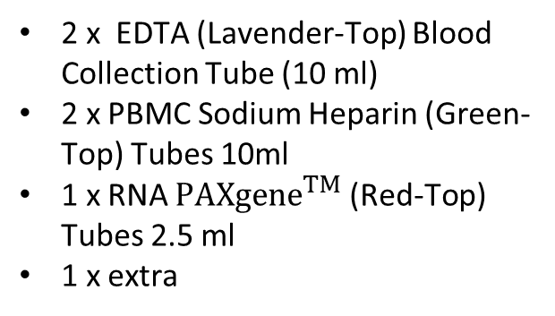
Kit B: PBMC, DNA, & RNA Labels
Kit Number Labels
Collection Tube Labels
1 x placed on the Sample Form
4 x extra (dispose if not used)
2 x PBMC Sodium Heparin (Green-Top) Tubes 10ml
2 x EDTA (Lavender-Top) Blood Collection Tube (10 ml)
Site ID, Family ID, and Individual ID Labels
2 x EDTA (Lavender-Top) Blood Collection Tube (10 ml)
2 x PBMC Sodium Heparin (Green-Top) Tubes 10ml
1 x RNA ${PAXgene}^{TM}$ (Red-Top) Tubes 2.5 ml
1 x extra
1 x RNA ${PAXgene}^{TM}$ (Red-Top) Tubes 2.5 ml
Notes:
In Blood Kit B, you will receive 2 kit number labels. 1 should be placed on the sample form and the other is an extra. If unused, please throw away this extra label. The kit will also come with 6 site/family/individual ID labels. After filling these out, they should be placed on the 2 EDTA, 2 Sodium Heparin, and 1 PAXgene tubes. There will be 1 extra that you can keep as backup at your site, as long as it is blank. You will receive 2 collection tube labels that say PLASMA, which should be placed on the 2 10ml EDTA tubes. The 2 collection tube labels that say PBMC should be placed on the 2 sodium heparin tubes, and the one collection tube label that says RNA should be placed on the PAXgene tube.

Slide 37
Kit D: Genetic Testing Labels
Genetic Testing is now done primarily through Invitae. This kit should only be ordered and used for rare cases that are approved by FBS study management.
Kit Number Labels
1 placed on the Sample Form
1 placed on the outside of the cryobox that houses aliquot tubes during storage and shipment
Site ID, Family ID, and Individual ID Labels
1 x EDTA (Lavender-Top) Blood Collection Tube for Genetic Testing (3 ml)
Collection Tube Labels
1 x EDTA (Lavender-Top) Blood Collection Tube for Genetic Testing (3 ml)
Notes:
In Blood Kit D, you will receive 2 kit number labels. 1 should be placed on the sample form and 1 should be placed on the outside of the cryobox that houses aliquots. The kit will also come with 1 site/family/individual ID label. After filling this out, place it on the 3ml EDTA tube. Lastly, there will be a Collection Tube Label that says WBLD, which you should also place on the 3ml EDTA tube.

Slide 38

Handling/ Processing Study Specimens

Slide 39
Site Required Equipment
Blood Collection/Safety Equipment
Processing/Storage Equipment
Personal Protective Equipment (PPE)
Lab Coat, Safety Glasses
Tourniquet
Alcohol Prep Pad
Gauze Pad
Butterfly Needles
Bandage
Sharps Bin and Lid
Centrifuge capable of ≥2000 rcf with refrigeration to 4⁰C
-80⁰C Freezer
Wet Ice Bucket

Slide 40
Blood Draw Order
Sodium Heparin (Green-Top) Blood Collection Tube (10 ml) x 2
EDTA (Lavender-Top) Blood Collection Tube (10 ml) for DNA and Plasma x 2
EDTA (Lavender-Top) Blood Collection Tube (3 ml) for CLIA lab testing **only select participants**
Genetic Testing is now done primarily through Invitae. This kit should only be ordered and used for rare cases that are approved by FBS study management.
PAXgene™ Blood Collection Tube (2.5 ml) for RNA

Slide 41


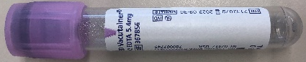

Sample Collection - Blood
Tube Type | Number of Tubes Drawn | Tube Image
1. Sodium Heparin (Green-Top) Blood Collection Tube (10 ml) for PBMC | X2
2. EDTA (Lavender-Top) Blood Collection Tube (10 ml) for Plasma & Buffy Coat | X2
3. EDTA (Lavender-Top) Blood Collection Tube (6ml) for CLIA lab testing *only select participants* | X1
4. PAXgene™ Blood Collection Tube (2.5 ml) for RNA | X1
*Genetic Testing is now done primarily through Invitae. This kit should only be ordered and used for rare cases that are approved by FBS study management.

Slide 42
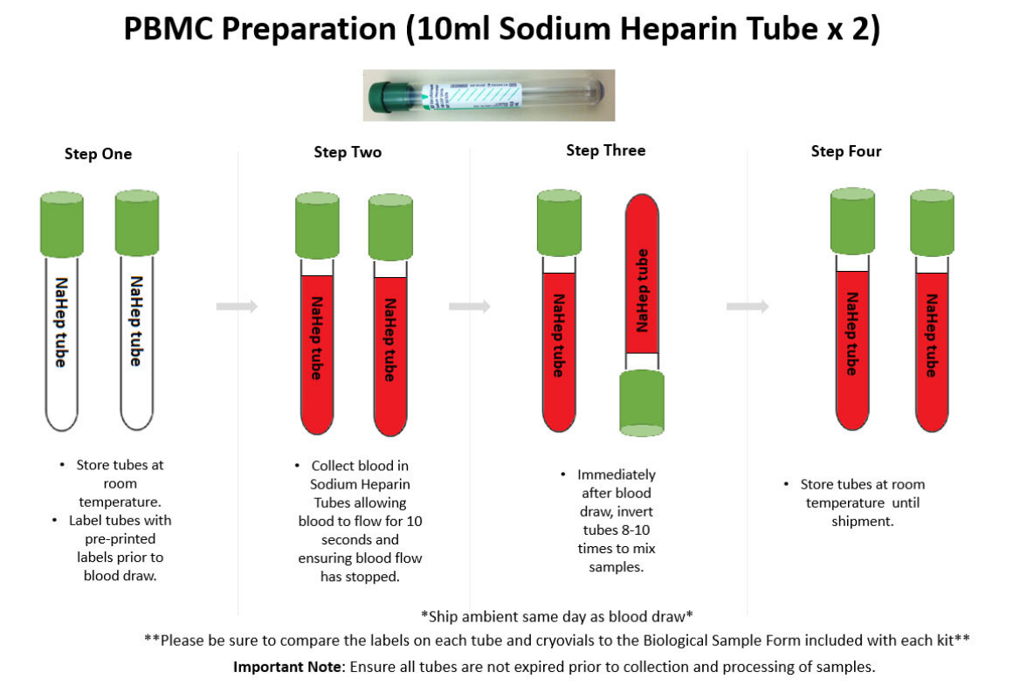

Slide 43
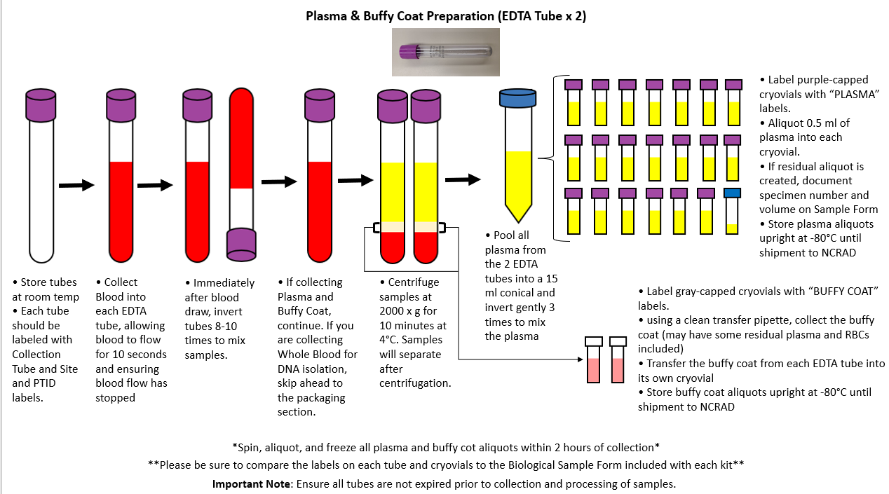
Notes:
This shows the process for Plasma and Buffy Coat preparation.

Slide 44
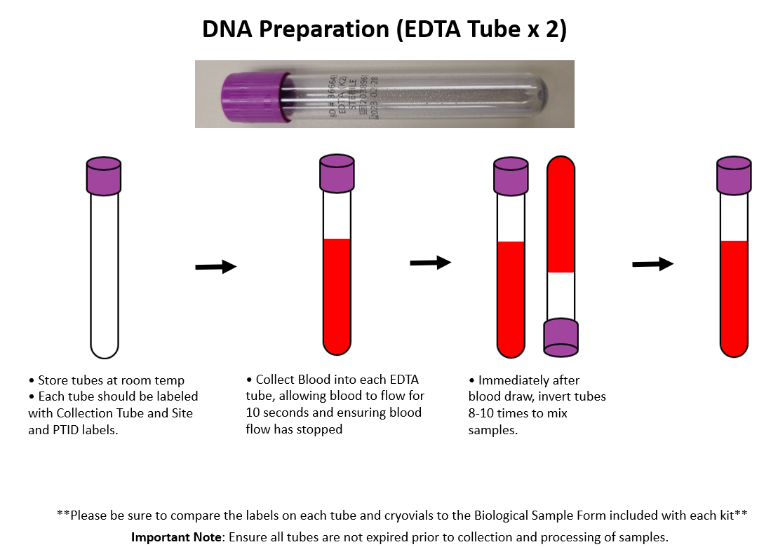

Slide 45
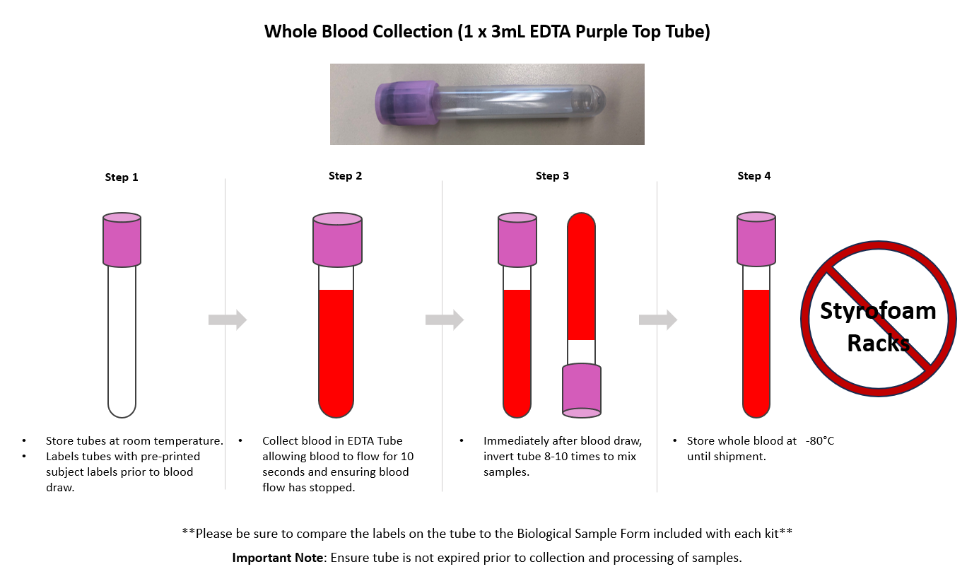
Genetic Testing is now done primarily through Invitae. This kit should only be ordered and used for rare cases that are approved by FBS study management.

Slide 46
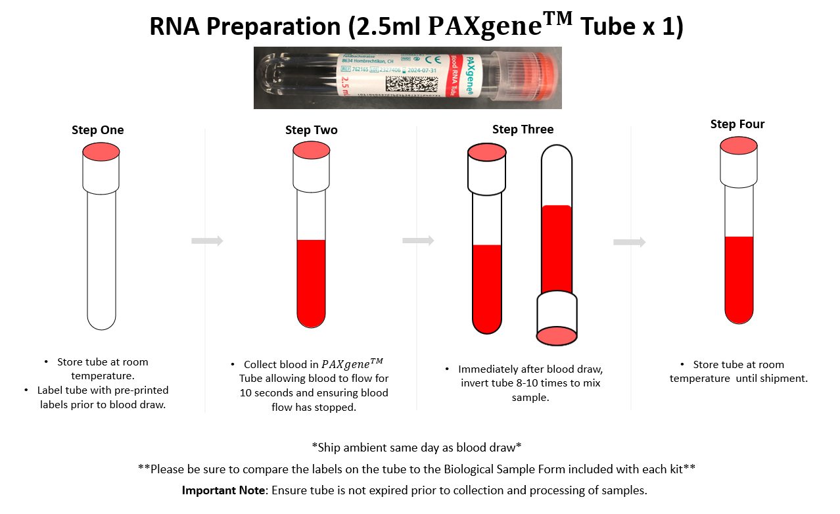

Slide 47
Sample Shipping

Slide 48
Ambient Sample Shipping
Ship Monday-Thursday Only
PBMC, Whole Blood (for DNA isolation), and RNA
Ship samples same day as collection

Slide 49
Ambient Sample Shipping
Sample Type | Tube Type | Kit Type
Whole blood for PBMC isolation | 2 x Sodium Heparin (GreenTop) Blood Collection tube (10 ml) | Kit B: PBMC, DNA, & RNA AND Kit A & C: PBMC, Plasma/Buffy Coat, & RNA
Whole blood for DNA isolation | 2 x EDTA (Lavender-Top) Blood Collection Tube (10 ml) | Kit B: PBMC, DNA, & RNA
Whole blood for RNA isolation | 1 x PAXgeneTM Blood Collection Tube (2.5 ml) | Kit B: PBMC, DNA, & RNA AND Kit A & C: PBMC, Plasma/Buffy Coat, & RNA

Slide 50
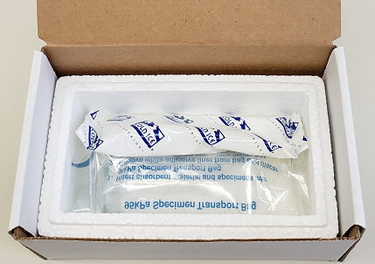
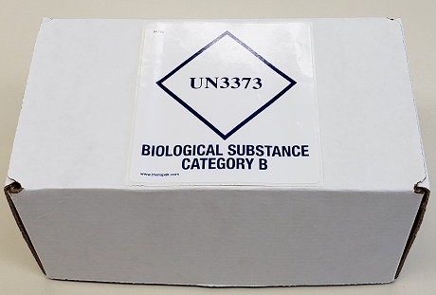
Ambient Sample Shipping
Place refrigerant pack in the freezer 24 hours prior to shipment.
Place filled and labeled Sodium Heparin, EDTA, and PAXgeneTM tubes within the slots in the absorbent pad and place in biohazard bag.
Place the kit number label on biohazard bag.
Place the refrigerant pack into the cooler on top of the filled biohazard bag. Place lid on cooler.
Place the cooler in the small IATA Shipping Box.
Place an extra copy of the “Biological Sample and Shipment Notification Form” within the shipping box along with a list of contents form.
Close shipping box and ensure labeled with UN3373 label.
Place box within a provided UPS ClinPak, seal, and place UPS label on outside of package.

Slide 51
Frozen Sample Shipping
Ship Monday-Wednesday Only
Plasma and Buffy Coat
Hold packaged samples in a -80°C freezer until pickup.
Batch Samples together
5 Cryoboxes
Batch shipping should be performed every 3 months or as a full shipment of specimens accumulates, whichever is sooner.

Slide 52
Frozen Sample Shipping
Sample Type | Tube Type | Kit Type
Plasma & Buffy Coat | Up to 20 x 2mL purple top cryovials with plasma AND Up to 2 x 2mL grey top cryovials with buffy coat | Blood Kit A & C: PBMC, Plasma/Buffy Coat, & RNA
Whole blood for Genetic Testing | 1 x EDTA (Lavender-Top) Blood Collection Tube (3 ml) Genetic Testing is now done primarily through Invitae. This kit should only be ordered and used for rare cases that are approved by FBS study management. | Blood Kit D: Genetic Testing Kit

Slide 53
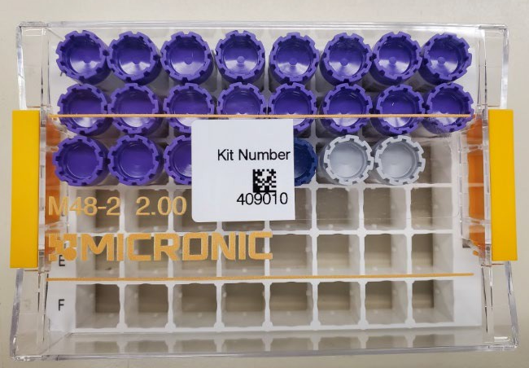
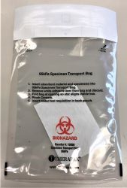
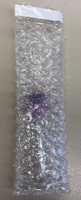
Frozen Shipping - Cryoboxes
Place frozen EDTA (3ml) tube (when applicable) in bubble wrap tube sleeves.

Slide 54
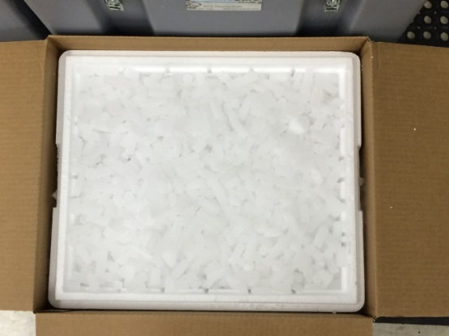
Frozen Shipping – Dry Ice Requirements
Fully cover the cryoboxes with about 2 inches of dry ice in the provided shipper.
Each Styrofoam shipper must contain about 45 lbs (20 kg) of dry ice.

Slide 55
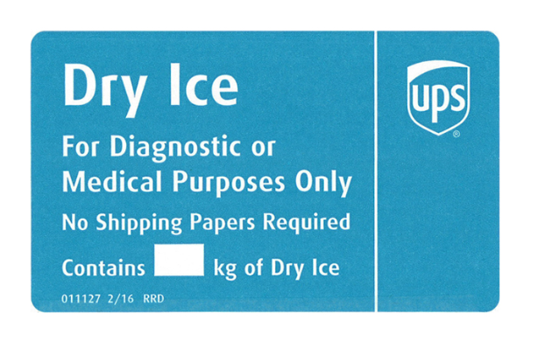
Frozen Shipping – Dry Ice Requirements
Dry Ice label should not be covered with other stickers and must be completed or the shipping carrier will reject/return your package!
Net weight of dry ice in kg
20.4

Slide 56
Shipping Frozen & Ambient Samples
Send Biological Sample and Shipment Notification Form to IU ahead of shipment
Email: alzstudy@iu.edu or
Fax: 317-321-2003

Slide 57
Shipping Regulations and Training
PLEASE NOTE:
All study personnel responsible for shipping should be certified in biospecimen shipping.
It is the responsibility of each site to ensure that the appropriate training has been provided and conducted in regards to IATA shipping.
Please see following slides for resources.

Slide 58
Federal Regulations/Training
Sites are responsible for ensuring proper training is obtained.
Current federal and international regulations require anyone directly involved with the shipment of potentially infectious materials and other regulated biological materials (including biological specimens and cultures) be properly trained on pertinent shipping requirements.
International Air Transport Association (IATA) Training
DGI Training Center 800-338-2291 DGItraining.com Provides IATA Certified Air Seminars and online courses | IATA Training Schools North America 1(514)390-6726 Europe, Africa & Middle East 41 (22) 799 2751 Asia, Australia & the Pacific 65 239 7232 www.iata.org Training schools located in 30 countries
Saf-T Pak Inc. www.saftpak.com Provides dangerous goods training via CD or on-site instruction for North America and Europe | Aiconsult Email: Airconsult@wanadoo.fr www.airconsult-bf.com
Bureau of Dangerous Goods LTD., TIANJIN Addr.: No.3 Yingshui road, Nankai district, Tianjin China Tel: 022-23495890 83326960 83326854 / Fax: 022-83326959 Email: cdmin@bdg-china.com.cn www.bdg-china.com.cn

Slide 59
UN3373 Biological Substance, Category B Training
Biological Substance, Category B are specimens being transported for “investigational purposes”
Recommend: investigator sites document training of category B/dangerous goods
We recommend establishing a record of your staff’s training and date of instruction
The training records must be made available upon request by the appropriate national authority
Additional information from the Department of Transportation (DOT) can be found on their website http://hazmat.dot.gov

Slide 60
Biological Sample and Shipment Notification Forms
A copy of the sample form must be emailed to NCRAD prior to the date of sample arrival.
Please include sample forms in all shipments of frozen and ambient samples.
This means you will need to print a copy of the completed Sample Form, so you have to include in both shipments, if using Blood Kit A or C.
Email: alzstudy@iu.edu
Fax: 317-321-2003

Slide 61
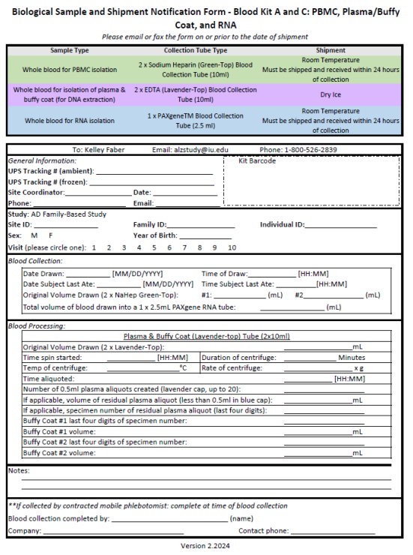

Slide 62
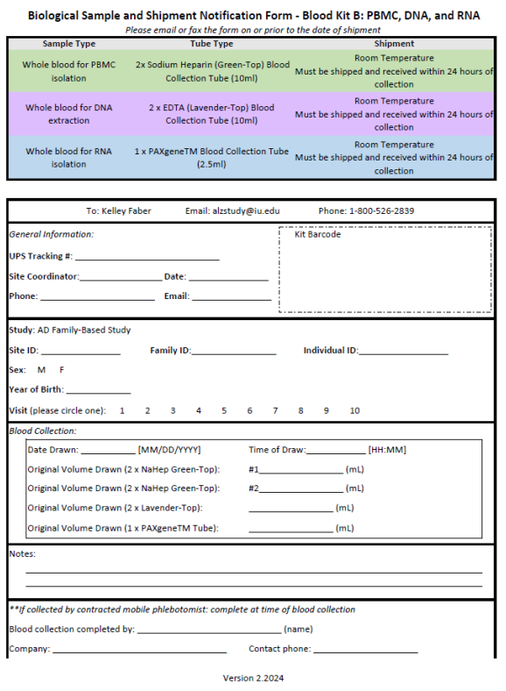

Slide 63
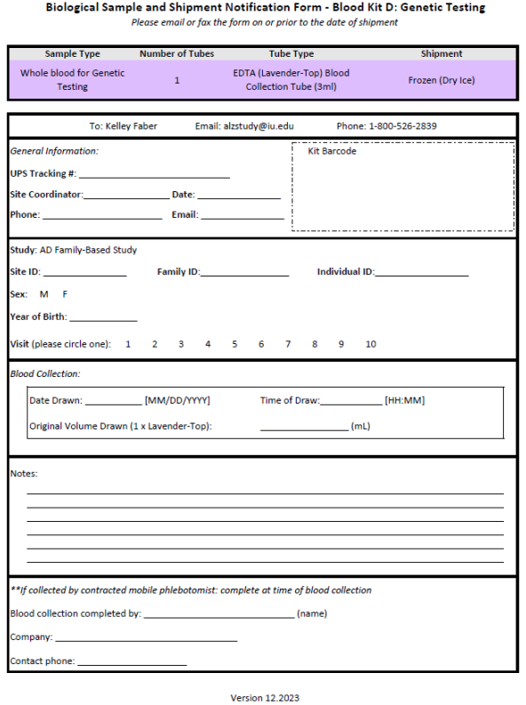
Genetic Testing is now done primarily through Invitae. This kit should only be ordered and used for rare cases that are approved by FBS study management.

Slide 64
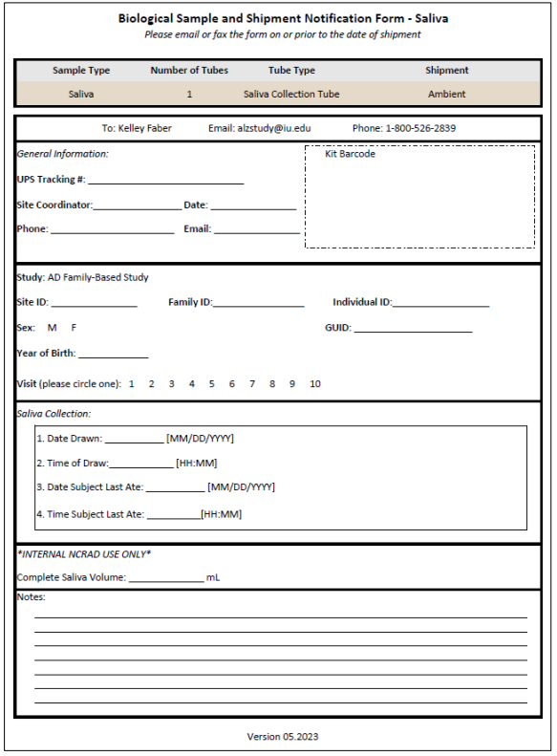

Slide 65
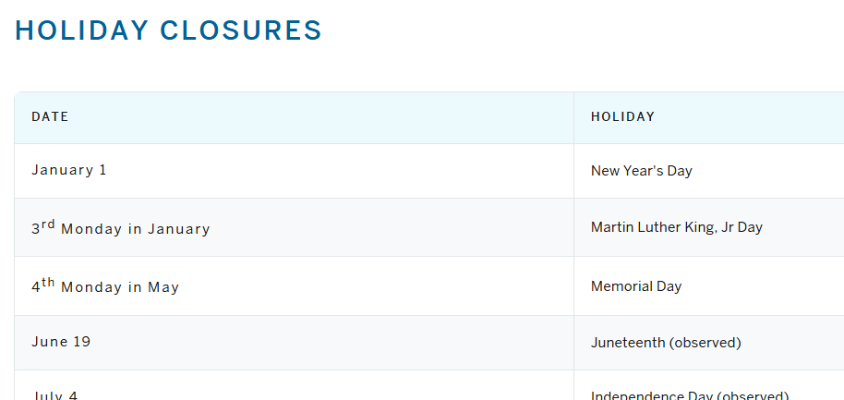
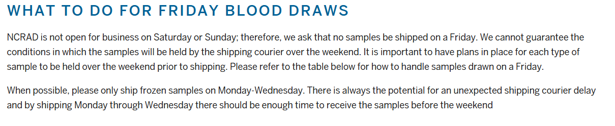
NCRAD Website Helpful Pages
https://ncrad.iu.edu/contact/holiday-closures
https://ncrad.iu.edu/contact/friday-blood-draws

Slide 66
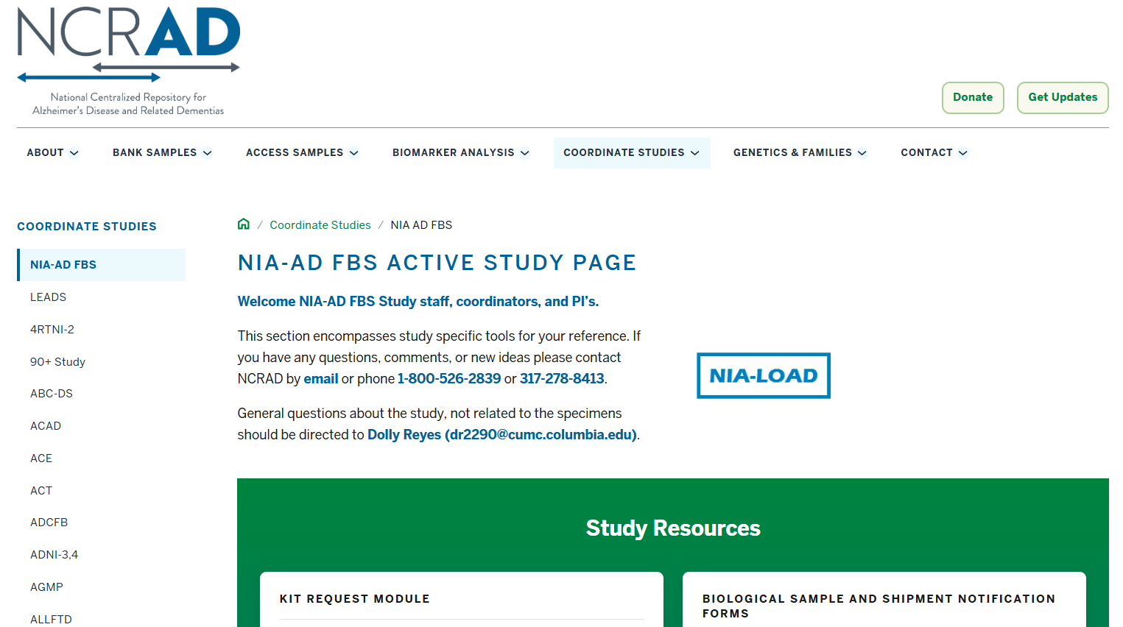
FBS Active Study Page

Slide 67
Contact Information
Questions?
Please contact NCRAD Coordinators at:
Phone: 1-800-526-2839 or 317-278-1133
E-mail: alzstudy@iu.edu or rdw2@iu.edu
Website: www.ncrad.org

