Slide 1

Collection and Shipment Training

Slide 2
Training Overview: ACT
Kit Review & Kit Request Module
Specimen Labeling Instruction
Sample Collection and Processing
Shipping and Packaging Sample Shipments
Creating Airbills and Scheduling UPS Pickup
Sample Form
Common Nonconformance Issues
NCRAD Resources and Contact Information

Slide 3
Kit Request Module
HTTPS://KITS.IU.EDU/ACT

Slide 4
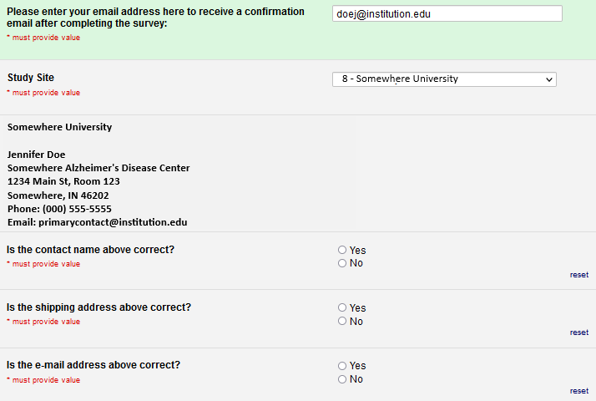
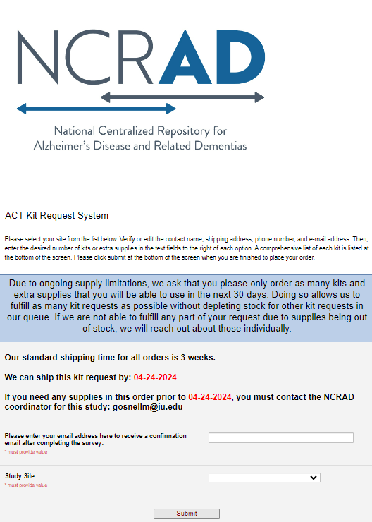
ACT Kit Request Module
Enter Email
Choose your site from drop-down list
The coordinator name and contact information will appear.
Verify that this information is accurate and correct if necessary.

Slide 5
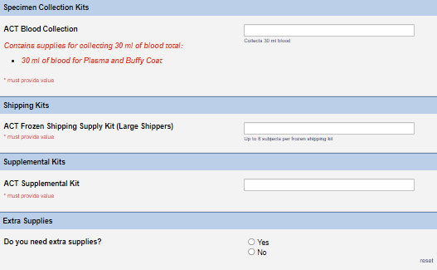
ACT Kit Request Module
Can place an order for:
- Blood collection kit
- Frozen shipping kit
- Supplement kit (one per year)
- Individual supplies
Enter kit order amounts
Please do not order in bulk. Kit contents expire.
Click “Submit” to complete your request
*Allow for 3 weeks for kits to arrive when placing order
Notes:
Please do not order in bulk. Kits do expire. Plan for a month in advance

Slide 6
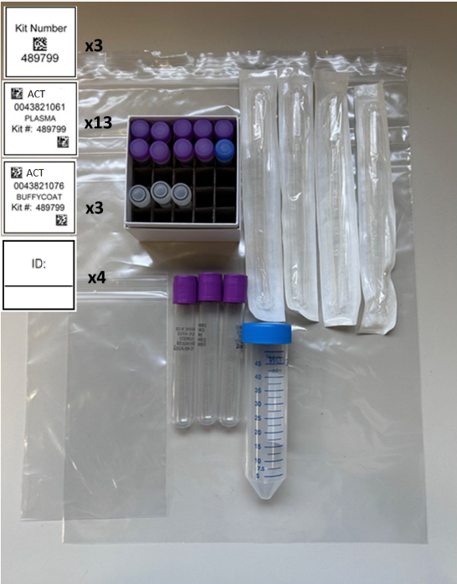
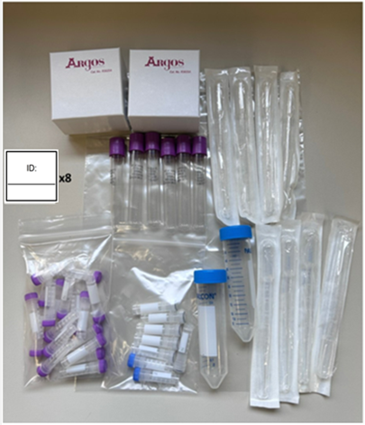
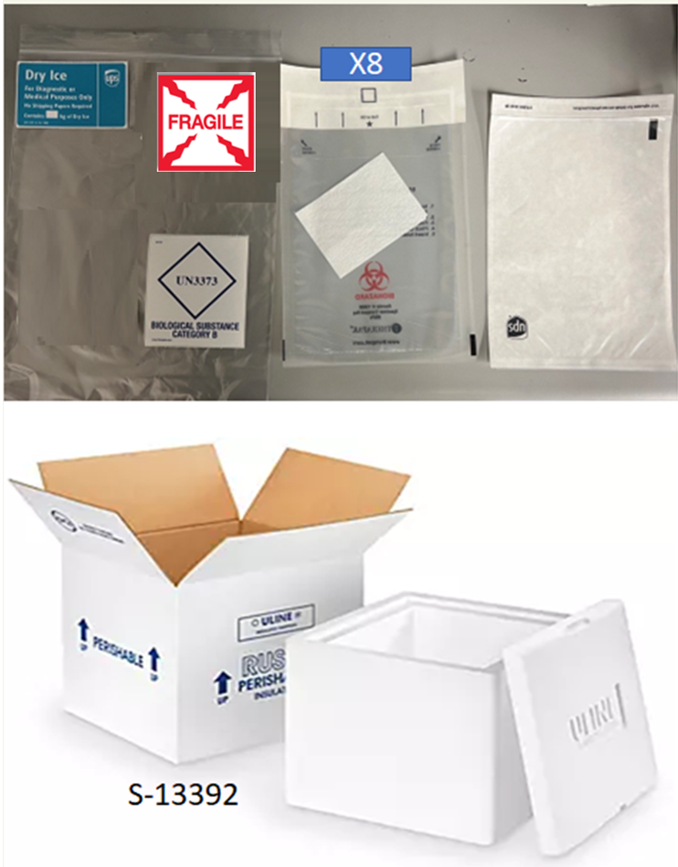
ACT Kit Types
ACT Blood Kit
ACT Supplemental Kit
ACT Frozen Shipping Supply Kit
(Large Shippers)

Slide 7
Specimen Labels

Slide 8
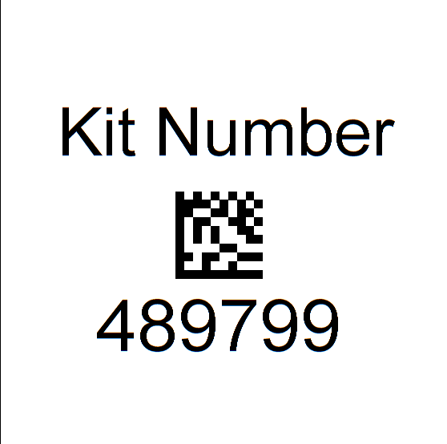
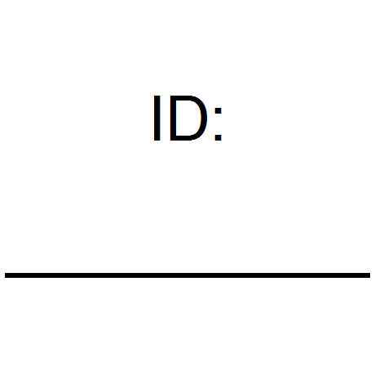
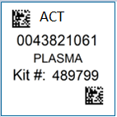
Three Label Types
Kit Number
Participant ID
Collection Tube and Aliquot

Slide 9
Kit Number Labels
Ties all biospecimens and kit contents together for each participant at each visit
Provides quality assurance
Will be placed on the following locations:
  Blood Sample and Shipment Notification Forms
  Cryoboxes that house aliquots during shipping
  One extra label provided

Slide 10
Participant Labels
Participants will be identified by their participant ID and sites will be responsible for handwriting this onto the provided labels
  Must use fine point permanent marker
Placed on blood collection EDTA tubes

Slide 11
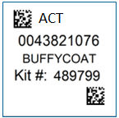
Collection Tube and Aliquot Labels
Collection Tube/Aliquot labels are specific to the type of biospecimen
Have 4 components:
  Study name
  10 digit unique specimen barcode
  Collection Group
  Kit number
Place on EDTA tubes and processed cryovials

Slide 12
Blood Collection Tubes
Label 1: Participant ID Label
Label 2: Collection Tube label
All collection tubes will have two labels:
  Handwritten Participant ID label
  Collection tube label

Slide 13
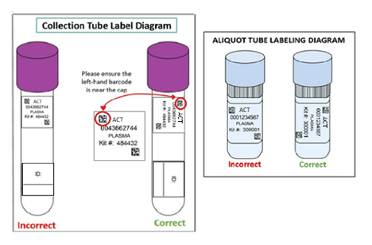
Labeling Biologic Samples
Write participant ID with fine-point marker prior to label placement
Label all collection and aliquot tubes before cooling, collecting, processing or freezing samples
Label only one participant’s tubes at a time to avoid mix-ups
Wrap the label around the tube horizontally. Label position is important for all tube types
Make sure the label is completely adhered by rolling between your fingers

Slide 14
Handling/Processing
Study Specimens

Slide 15

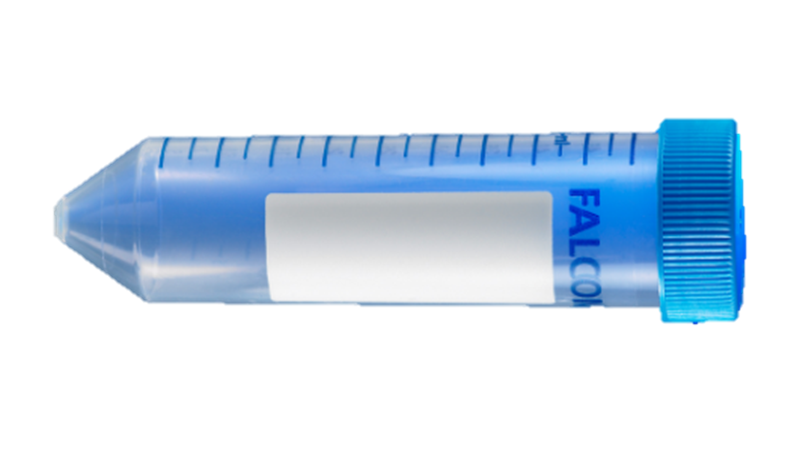
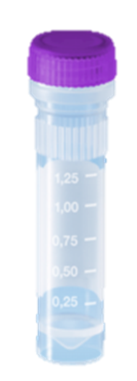


Specimen Collection and Processing:
Specimen Tube Types
Type | Tube Photo | Size | Purpose | Amount
EDTA Tube |  | 10 ml | Whole blood collection | 3
Conical Tube |  | 50 ml | Pooling plasma from EDTA tubes | 1
Cryovial |  | 2 ml | 1.5 ml aliquots of plasma from conical tube | Up to 9
Cryovial |  | 2 ml | Aliquot residual plasma <1.5 ml after filling purple top cryovials | 1
Cryovial |  | 2 ml | ~1.0 ml aliquots of buffy coat from EDTA tubes | 3

Slide 16
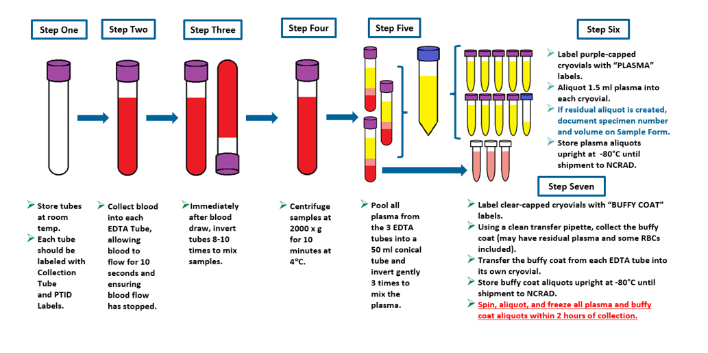
Plasma/Buffy Coat Collection and Processing: 30 ml

Slide 17
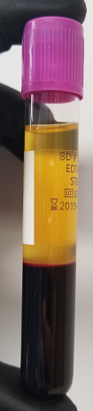
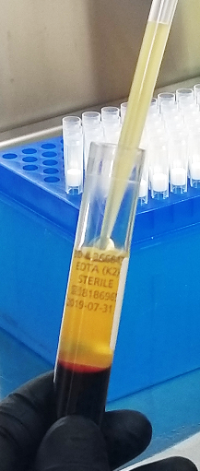
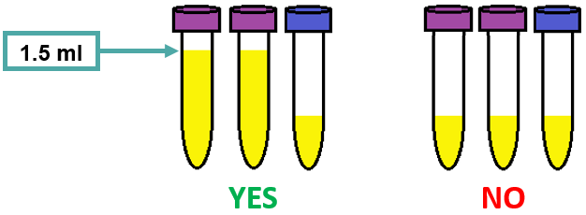
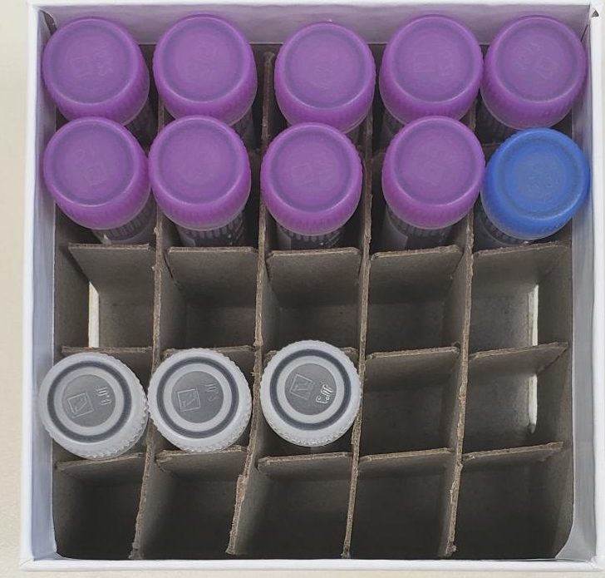
Plasma Collection
  Processed plasma creates up to nine 1.5ml aliquots in purple cap cryovials
  Residual plasma is placed in blue cap cryovial
10 mL EDTA tube after centrifuge

Slide 18
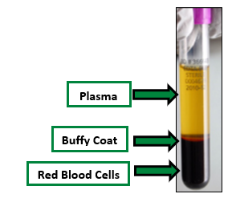
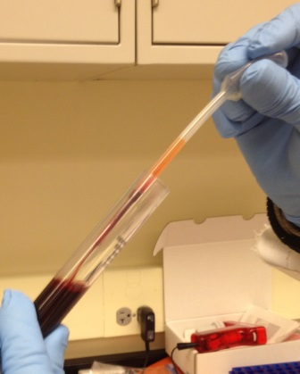

Buffy Coat Collection
Buffy Coat
Expected to have a reddish color from the RBCs.
Be sure to only place the buffy coat from one EDTA tube into each cryovial
Create up to 3 buffy coats

Slide 19
Packaging Sample Shipments

Slide 20

Frozen Shipment Packaging
All samples shipped frozen to NCRAD Monday-Wednesday ONLY
Hold packaged samples in a -80°C freezer until pickup
Include copy of Blood Sample and Shipment Notification Form in shipper
Sites provide pelleted dry ice for shipments
~45 lbs. per batch shipment (8 cryoboxes per large shipper)

Slide 21
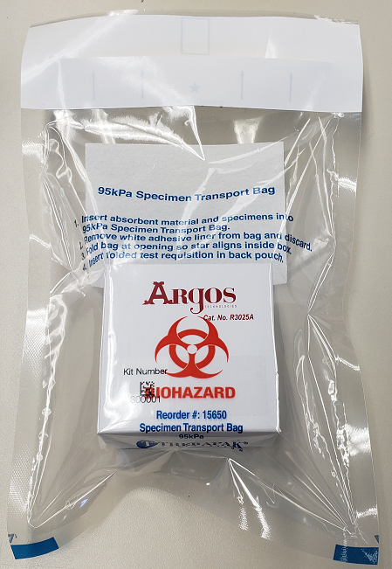
Frozen Shipment Packaging
Use the biohazard bag to package the frozen 25-slot cryobox
Confirm the kit number label has been placed on the outside of the cryobox

Slide 22
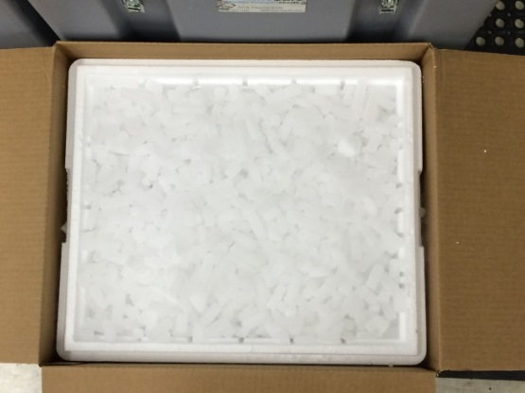
Frozen Shipment Packaging
Place 2-3 inches of pelleted dry ice in the bottom of the Styrofoam shipping container, then insert the cryoboxes laying upright
Fill shipper to the top with pelleted dry ice
Each Styrofoam shipper must contain about 45 lbs (20 kg) of pelleted dry ice
Each large frozen shipper holds up to 8 cryoboxes

Slide 23
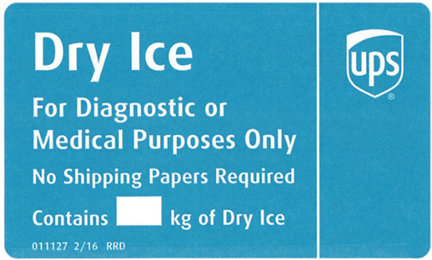
Frozen Shipping –
Dry Ice Requirements
Dry Ice label should not be covered with other stickers and must be completed, or the shipping carrier will reject/return your package!
Net weight of dry ice in kg
20

Slide 24
Creating Airbills/Scheduling Pickups

Slide 25
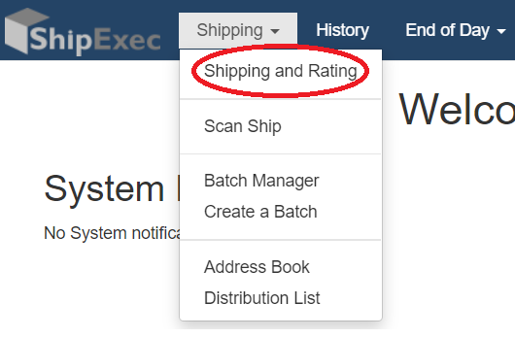
UPS ShipExecTM Thin Client Website
Log into the ShipExec Thin Client: https://kits.iu.edu/UPS
Click on the “Shipping” dropdown and click on “Shipping and Rating”

Slide 26
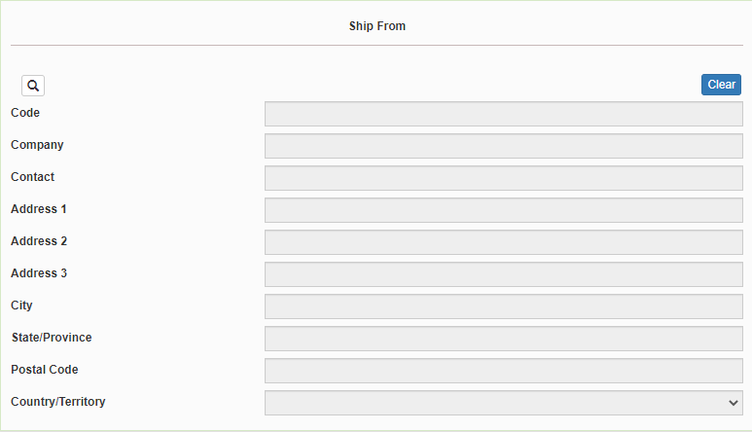
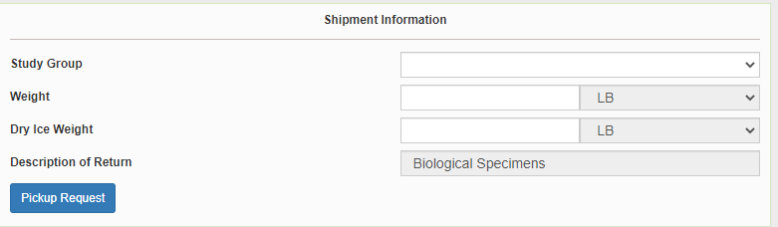
Finding Your Contact Information
On the right side of the screen, choose the name of your study from the “Study Group” drop down menu
  This step must be done 1st
On the left side of the screen, Click on the magnifying glass icon

Slide 27
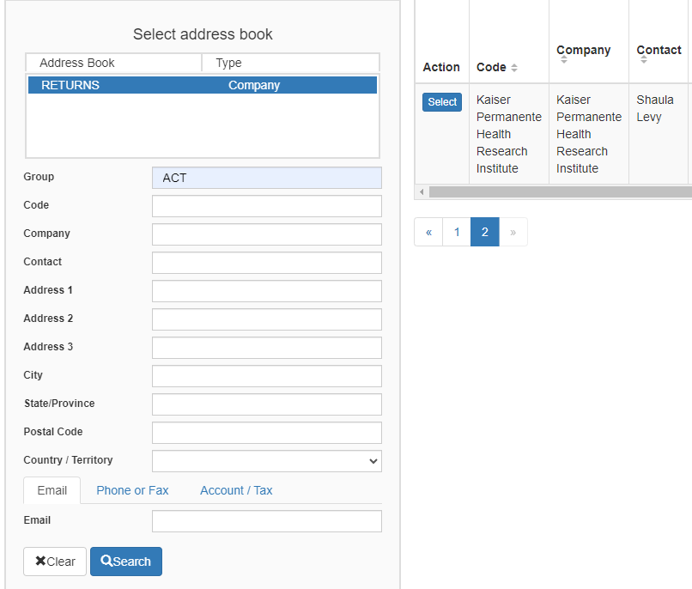
Finding Your Contact Information
On the right side of the screen, a list of all the site addresses within the study you selected should populate
User can filter the search for their address further by filling in the “Company”, “Contact”, or “Address 1” fields
Hit “Search” when ready.
Once you have found your site address, click on the “Select” button to the left of the address
If any information needs to be updated, please reach out to the NCRAD Coordinator of your study

Slide 28
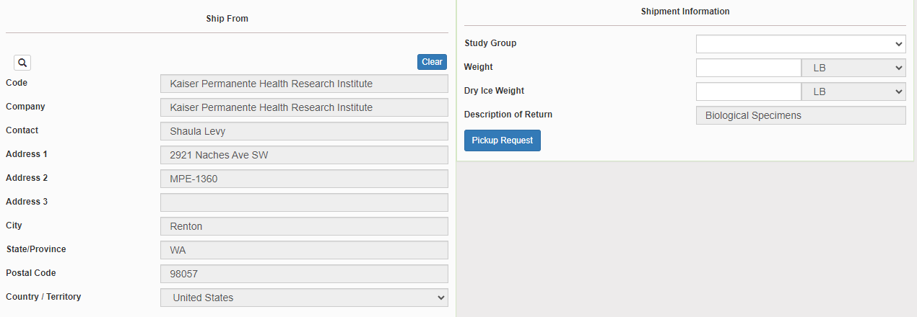
Verify Information
Please double check that both the shipping information AND study reference are correct for this shipment

Slide 29
Entering Shipment Information
  Frozen shipments
    Enter the total weight of your package in the “Weight” field
    Enter the dry ice weight in the “Dry Ice Weight” field
      The “Dry Ice Weight” field cannot be higher than the “Weight” field (will receive an error message)

Slide 30
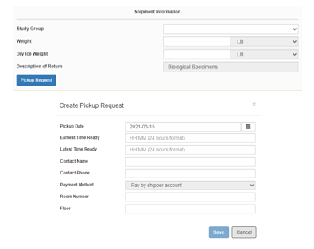
Need to request UPS Pickup?
Click on the “Pickup Request” button
Fill out all fields for the pickup request
Enter in the “Earliest Time Ready” and “Latest Time Ready” in 24-hour format
  Users must schedule pickup minimum 1 hour before “Earliest Time Ready”
Choose a name and number that is the best to contact if the UPS driver has questions related to picking up your package
Entering the Room Number and Floor will help the UPS driver locate your package
  Room number field is free text
  Floor field is numerical only
Hit “Save” when done

Slide 31
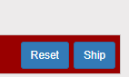
Shipping Packages
If all fields in “Ship From” and “Shipment Information” fields are completed (and if necessary, pickup request is completed), click Ship in the bottom right corner of the page

Slide 32
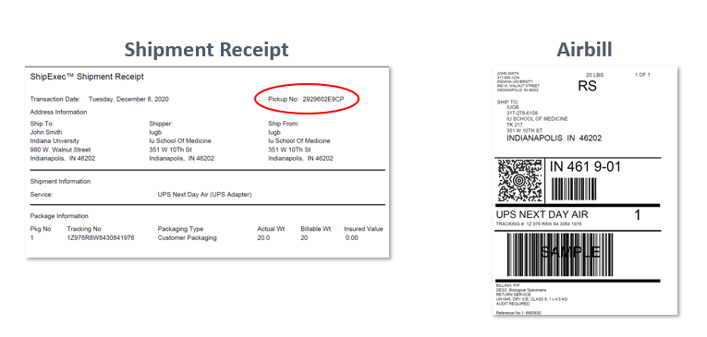
Accessing Airbill
Two documents will be created
Save the Shipment Receipt and the UPS Waybill
The “Pickup No:” is the reference number to your specific pickup request in case there are any issues with your package being picked up by UPS
Check Pickup Status by going to UPS.com, click on the Shipping, select Schedule a Pickup, and look on the right side of screen to click on “Pickup Request Status”. Enter in the Pickup No. listed on receipt into PRN field and submit

Slide 33
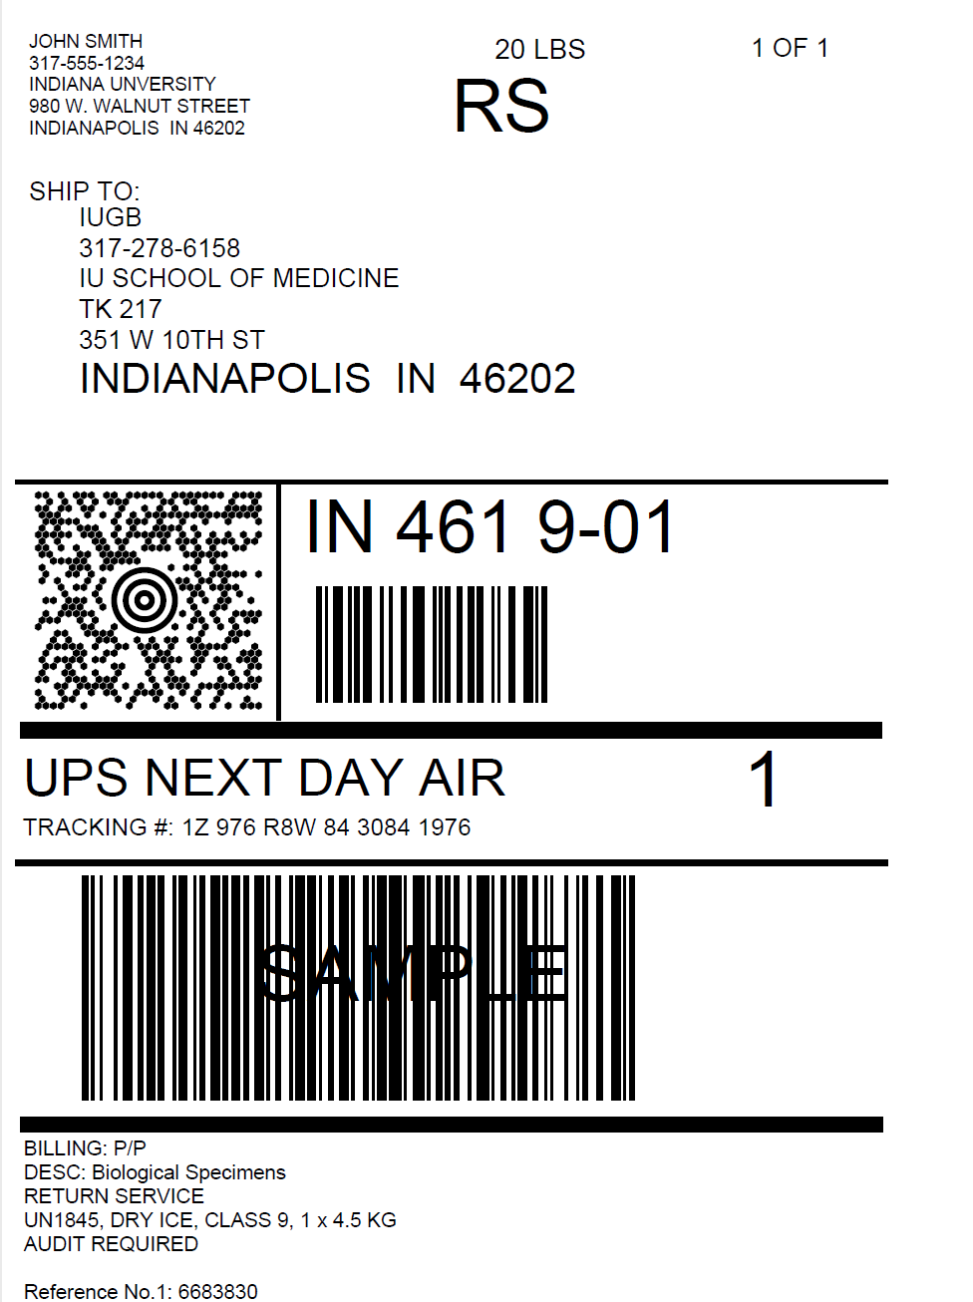
Accessing Airbill
Print out the UPS air waybill
Fold the UPS air waybill and slide it inside the plastic UPS sleeve (NCRAD will provide these in kit requests)
Peel the back off the plastic UPS sleeve and stick the sleeve to your package, making sure it is laying as flat as possible along the surface of the package.

Slide 34

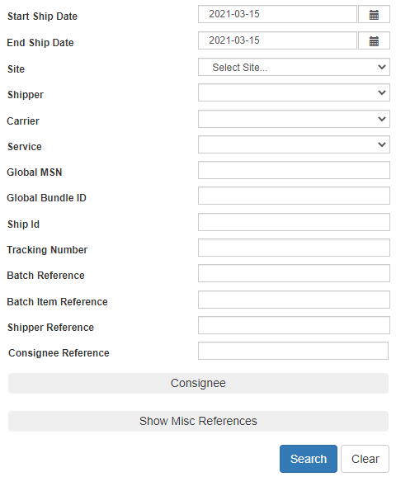
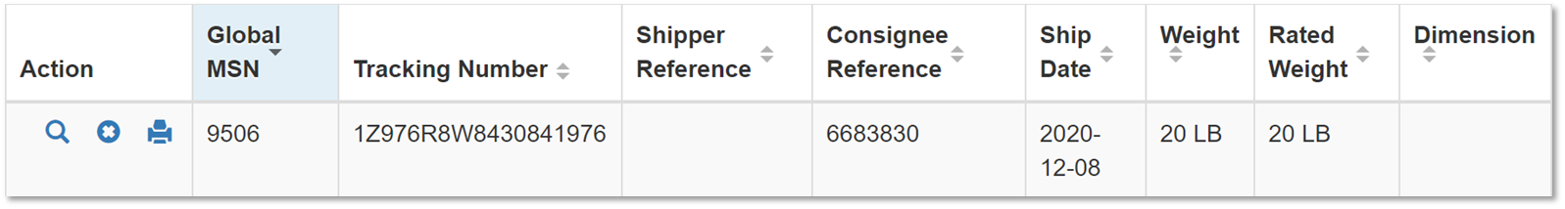
Creating Airbills & Scheduling Pick Ups:
Reprinting/Voiding Airbills
Reprint by clicking printer icon
Void by clicking the X icon
To reprint airbill or void a shipment, click “History” at the top of the ShipExec Thin Client portal
If your shipment doesn’t automatically pop up, enter in the date of shipment and then click “Search”

Slide 35
Blood Sample and Shipment Notification Form

Slide 36
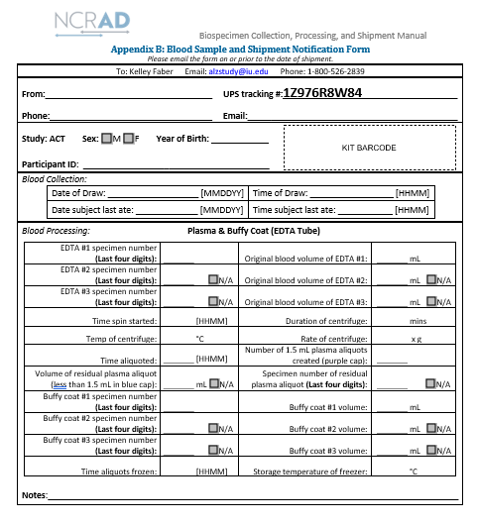

Slide 37
Blood Sample and Shipment Notification Form
A copy of the sample form must be emailed or faxed to NCRAD prior to the date of sample arrival.
Please include sample forms in all shipments of frozen samples.
Email: alzstudy@iu.edu

Slide 38
Noncomformance Issues

Slide 39
Non-Conformance | Solution
Low volume aliquots | Put cryovials in a row, aliquoting in order until sample is depleted
Tubes received frozen at an angle/inverted | Carefully place tubes upright in freezer and in shipper
Aliquots are not labeled or labeled incorrectly | Refer to training or MOP for correct label placement. Save all labels until samples are packed for shipping.
All frozen samples for one participant are not sent within one shipment box | Keep plasma and buffy coat for individual participants together. Use one cryobox per participant
Fields on Blood Sample and Shipment Form left blank or incorrect data is given | Complete Blood Sample and Shipment Form during participant’s study visit while samples are processed
Blood Sample and Shipment Forms are not e-mailed or faxed to NCRAD before shipment arrives | Make copy of participants completed form after visit and save until shipment.

Slide 40
NCRAD Website

Slide 41
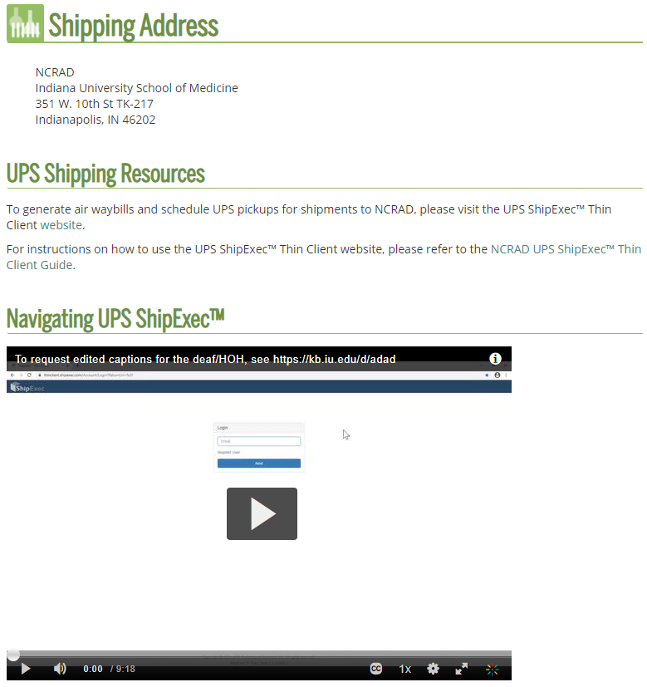
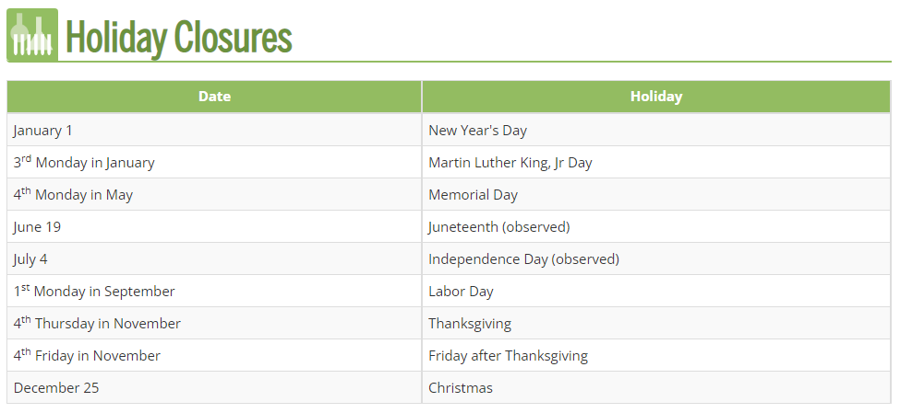
NCRAD Website: Helpful Pages
https://ncrad.org/contact/hours/holiday-closures
https://ncrad.org/shipping_address.html

Slide 42
Contact Information
Mica Gosnell
Phone: (317) 274-7423
E-mail: gosnellm@iu.edu
General NCRAD Contact
Phone: (800) 526-2839
E-mail: alzstudy@iu.edu
Website: www.ncrad.org

